Slide 1
South, East, & Southeast asia
Political Map

Slide 2
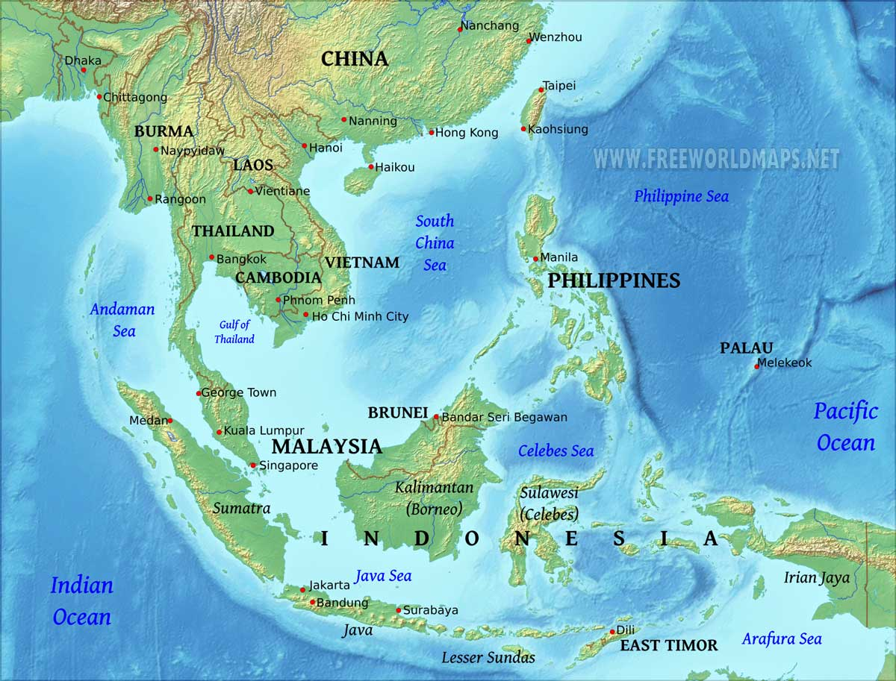
South, East, & Southeast asia
The southeast region of the entire Asian continent is known as Southeast Asia. It is an exceptional part of the continent. Most of the areas are bounded by the sea.

Slide 3
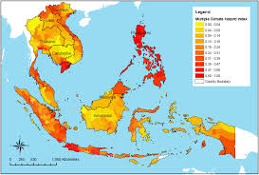
South, East, & Southeast asia
Southeast Asia includes the second biggest rain forest of the world. The entire zone is hot and humid. But the main climate is tropic. There is a bit ups and downs in the temperature. Another specialty of Southeast Asia is its subtropical area. A large area is covered with such condition. Myanmar Himalayas has introduced this climate condition to the geographers. The north side of Vietnam is also included in the subtropical climate. It rains at a stretch for two months in the whole Southeast Asia geography. This is why rice and paddy grows well here. Rain tree is the major plant of the area. These giant looking tree is the producer of oxygen. The monsoonal wind causes a dry weather in some countries. It also brings rain in plenty all over the years. So, the Southeast Asia map has a multidimensional climate.

Slide 4
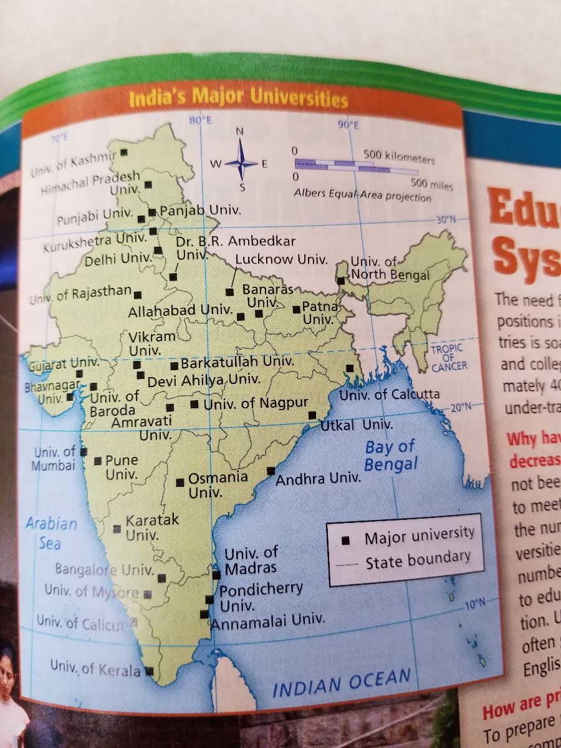
problems
The rapid growth in the number of India’s private colleges has resulted in education programs that turn out underprepared employees who lack the basic skills required by industry. The number of Indian students enrolling in universities and college outnumbers the space available. The number of colleges in India has tripled in the last ten years to satisfy the demand for education. Private companies are establishing training centers to fill the education gaps in India’s workforce.

Slide 5
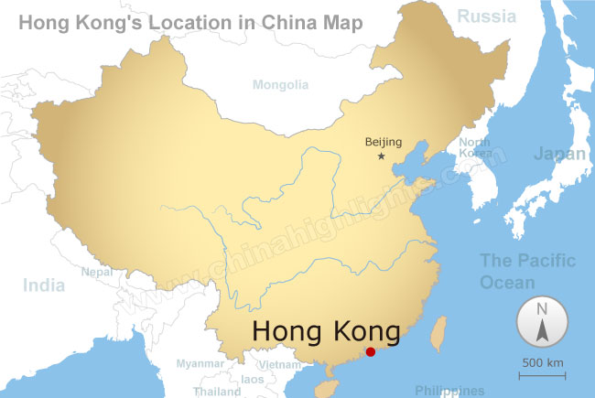
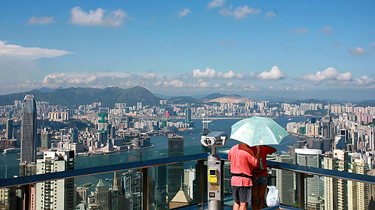
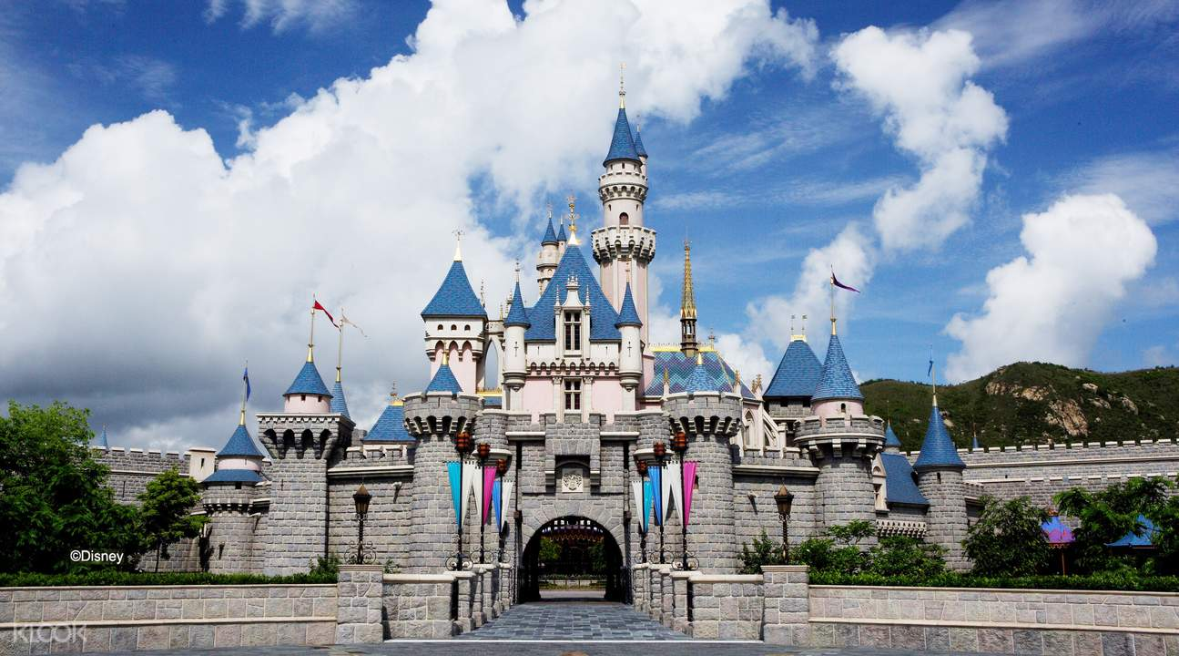
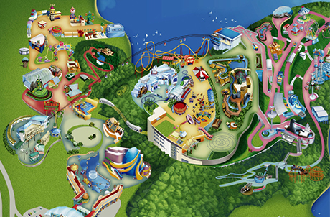
Hong kong, china
Victoria’s Peak
Disneyland – Hong Kong
Ocean Park – Hong Kong

Slide 6
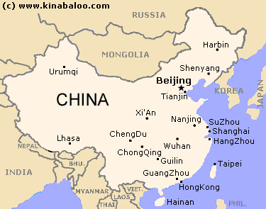
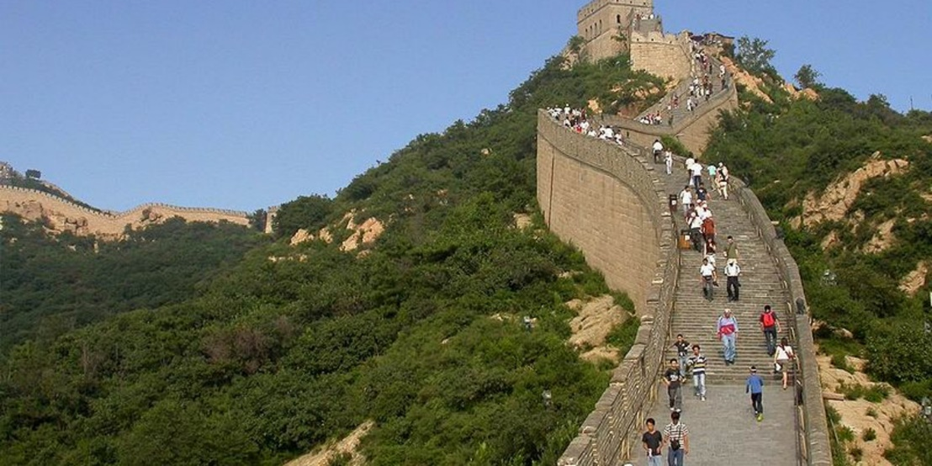
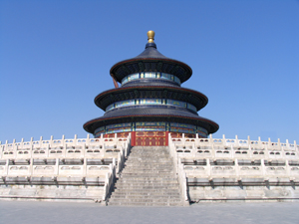
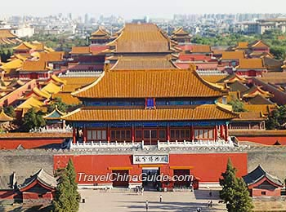
China – Beijing
Badaling Great Wall
Temple of Heaven
Forbidden City

Slide 7
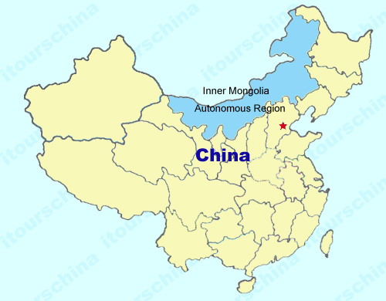
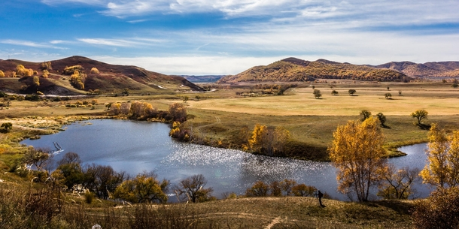
Physical china
Mongolian Plateau

Slide 8
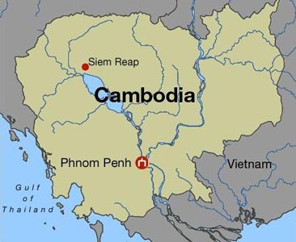
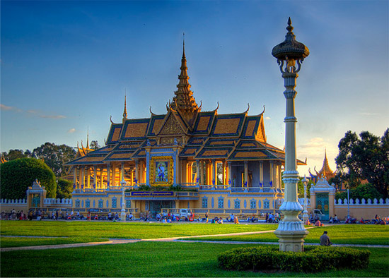
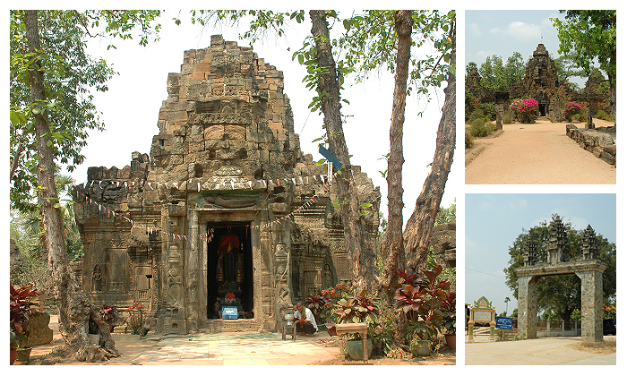
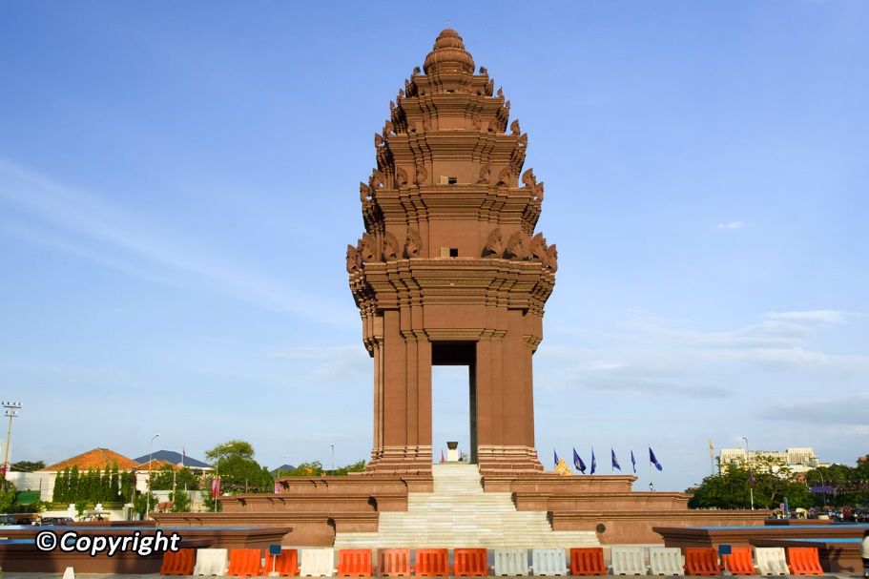
Cambodia – phnom penh
Royal Palace
Independence
Monument
Tonle Bati

Slide 9
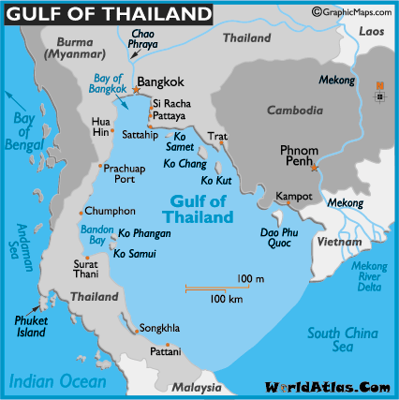
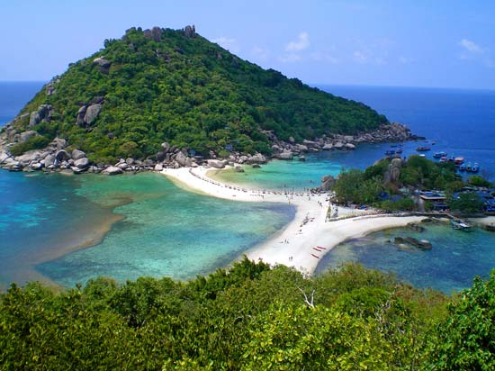
cambodia - physical
Gulf of Thailand

Slide 10
postcard
Dear Payton,
I had a great time in China. So far, China is my favorite place! Cambodia was ok. It was an old town. My next place will be headed to New Zealand. My journey is coming to an end! Then I will come home and see you!
Jeny

Slide 11
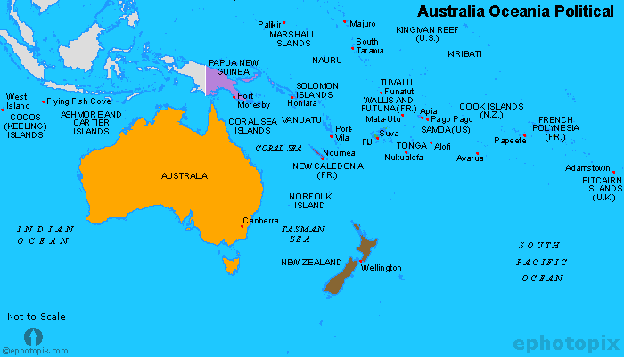
Australia & Oceania
Political Map

Slide 12
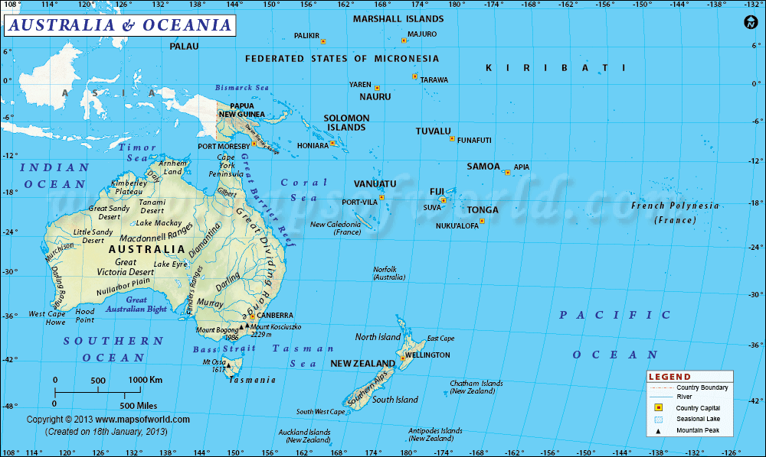
Australia & Oceania
Physical Map
Australia, Zealandia, and New Guinea are continental islands. These three regions share some physical features. All three have mountain ranges or highlands—the Great Dividing Range in Australia; the North Island Volcanic Plateau and Southern Alps in New Zealand; and the New Guinea Highlands in Papua New Guinea.

Slide 13
Australia & Oceania
Land and Climate. Oceania is generally hot and humid year-round. The islands have no true winter or summer, but many areas experience seasonal changes in winds, ocean currents, and rainfall. Australia's climate is governed largely by its size and by the hot, sinking air of the subtropical high pressure belt.

Slide 14
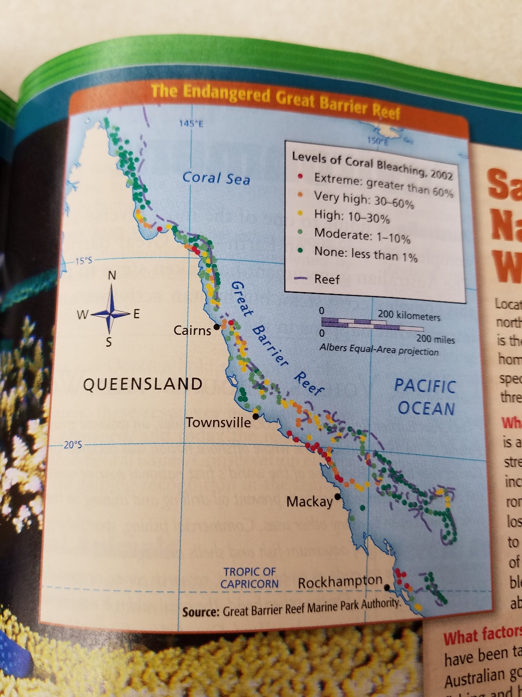
Problems
Increased water temperatures and environmental pollutants threaten the Great Barrier Reef. The survival of the reef and its marine life are at stake if this deterioration continues at this current rate. Extended exposure to unusually high water temperatures and pollution can kill coral reefs. Global warming has led to increased water temperatures, which are killing coral, altering the underwater ecosystem, and shrinking the Great Barrier Reef. Environmental protection programs that protect and monitor the condition of the Great Barrier Reef are key to its survival.

Slide 15
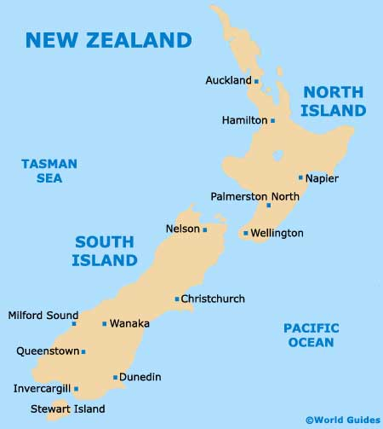
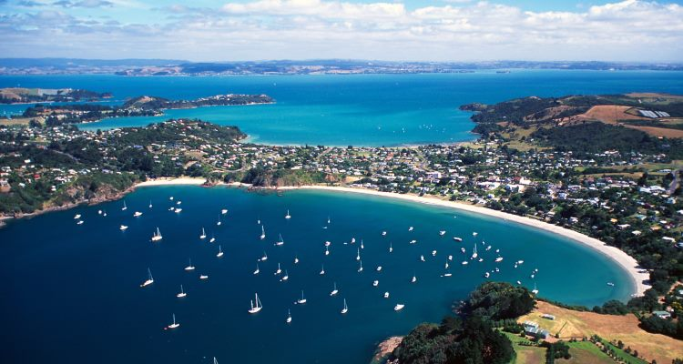
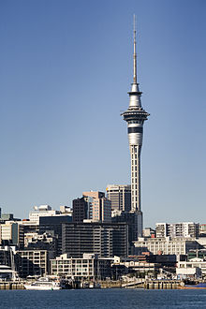
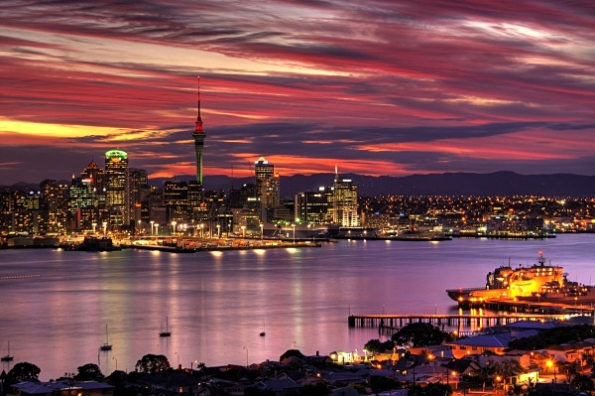
New Zealand - city
Waiheke Island
Waitemata Harbour
Sky Tower

Slide 16
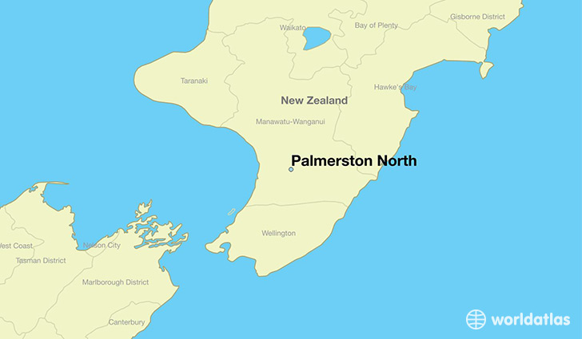
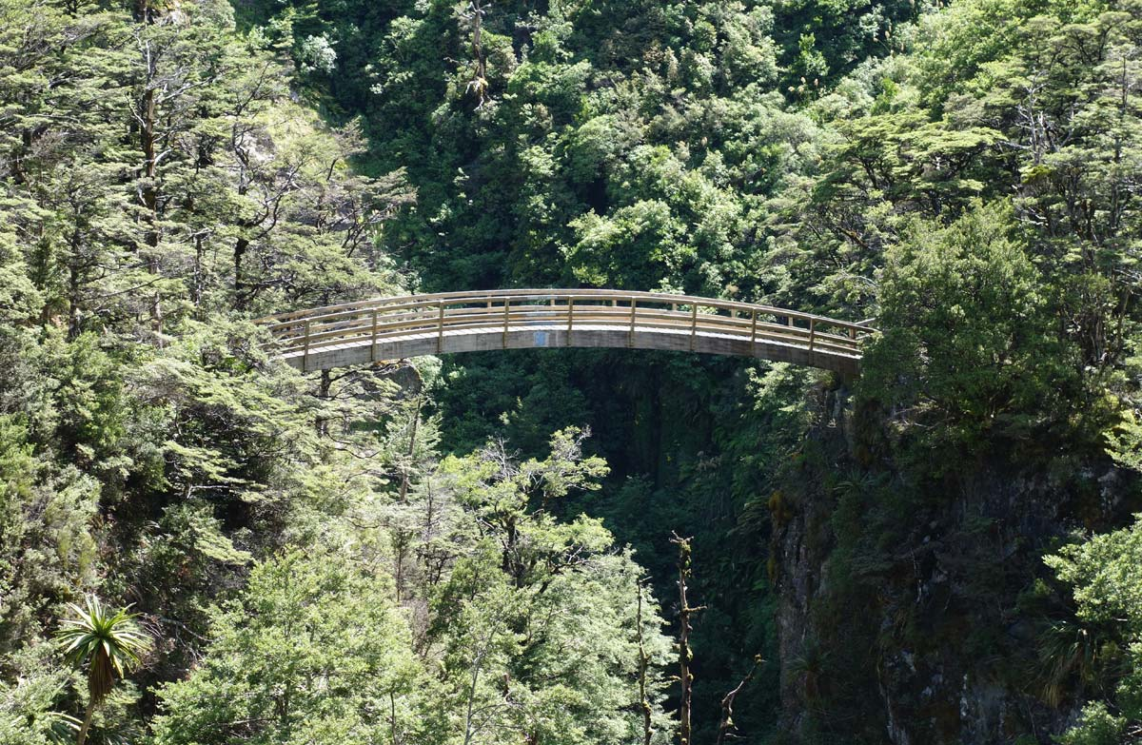
New Zealand – Palmerston north
Ruahine Forest Park
Te Manawa
Rugby Museum

Slide 17
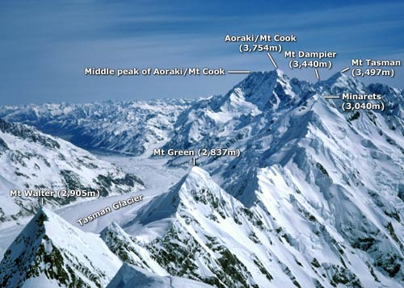
New Zealand - physical
Southern Alps

Slide 18
postcard
Dear Payton,
Only one more place left to visit, Boliva. I have had such a great time on my trip around the world. I visited some really neat places in New Zealand. It is a beautiful place.
Jeny

