Slide 1
Russia political map

Slide 2
Russia’s physical Map
Its easternmost tip is the Chukchi Peninsula. Russia's topography includes the world's deepest lake and Europe's highest mountain and longest river. The broad European Plain, or Volga River Plain extends from the Ural Mountains to its western borders. In the far southwest the Caucasus Mountains slice across the land.

Slide 3
Climate in Russia
In general, the climate of Russia can be described as highly continental influenced climate with warm to hot dry summers and (very) cold winters with temperatures of -30°C and lower and sometimes heavy snowfall.

Slide 4
Problems in russia
Since the beginning of Russian occupation, the Chechens have sought independence from foreign rule. The Russian occupation is part of everyday life in Chechnya. Chechens long for autonomy and continue to protest Russian occupation. The solution is to integrate Chechen representation into the Russian government may be the only solution to the problem.

Slide 5
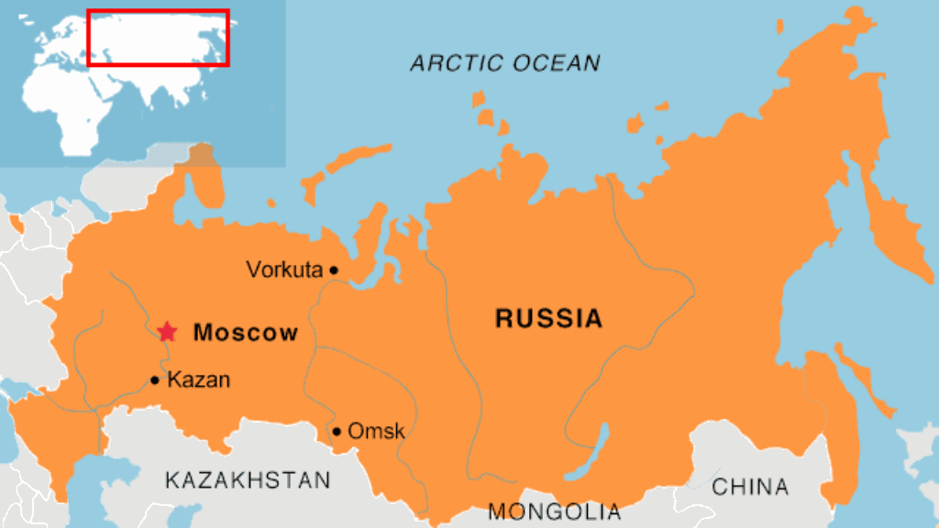
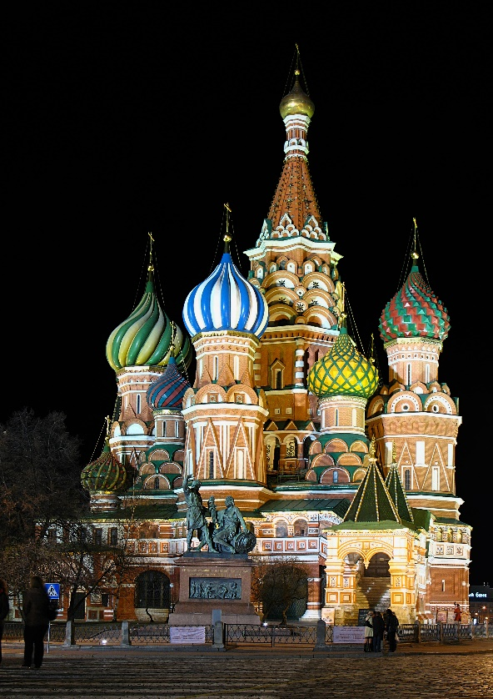
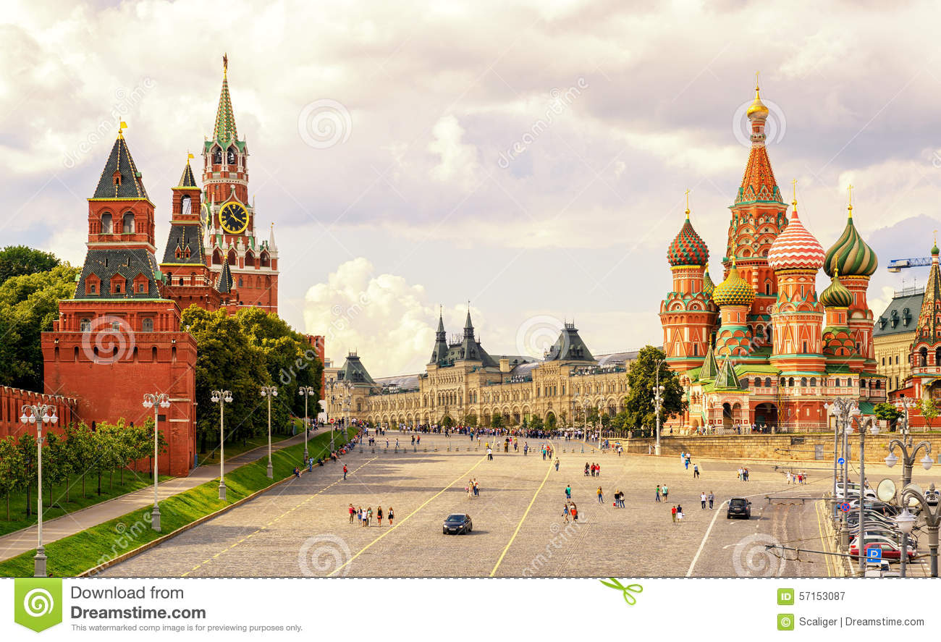
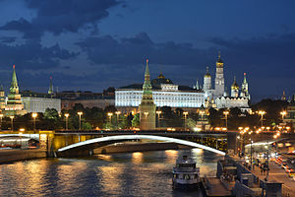
Moscow, russia
Kremlin Bridge
Saint Basil’s Catherdral
Red Square
Saint Basil’s Catherdral

Slide 6
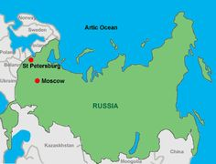
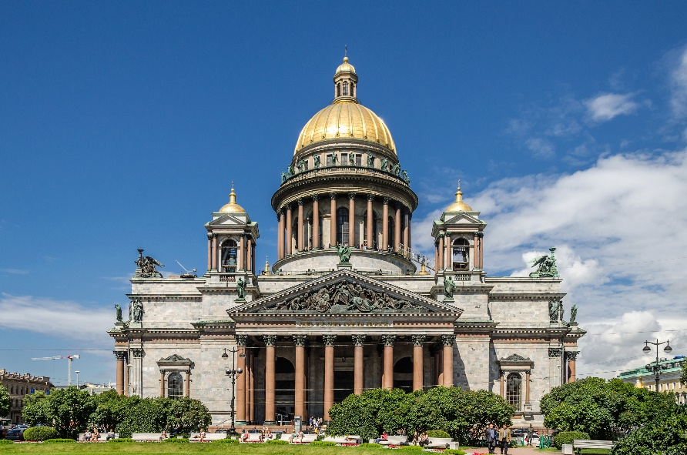
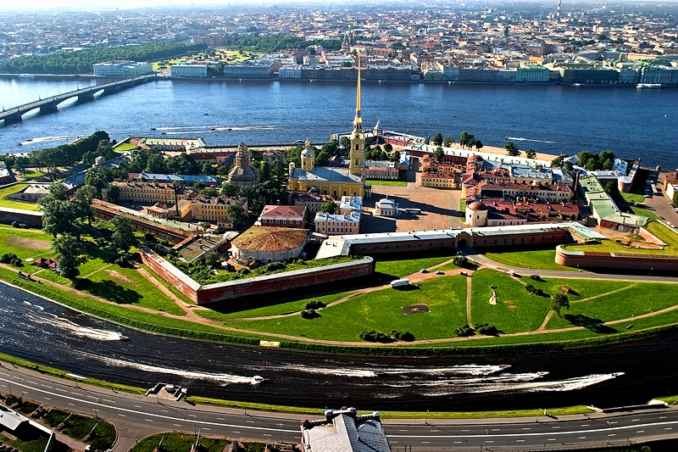
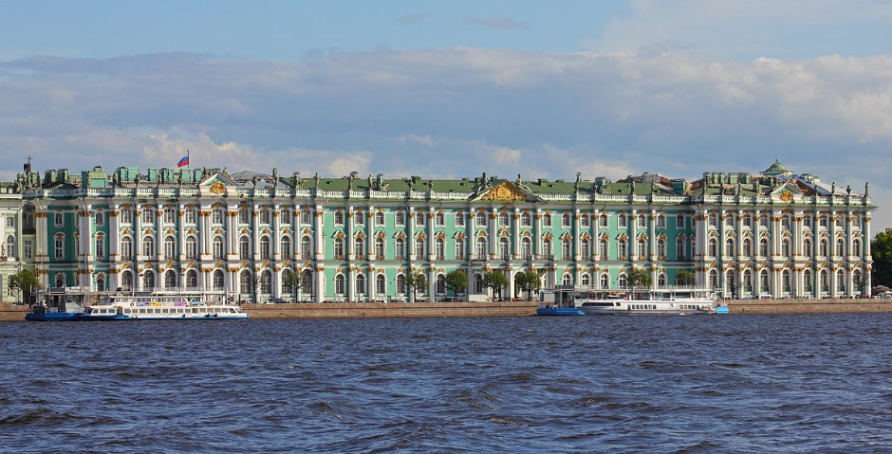
St. Petersburg, russia
Peter & Paul Fortress
Saint Isaac’s Cathedral
Hermitage Museum

Slide 7
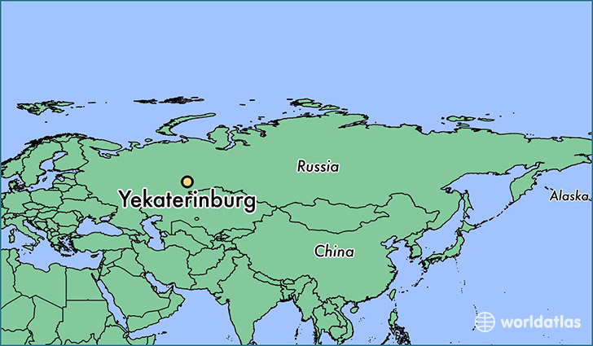
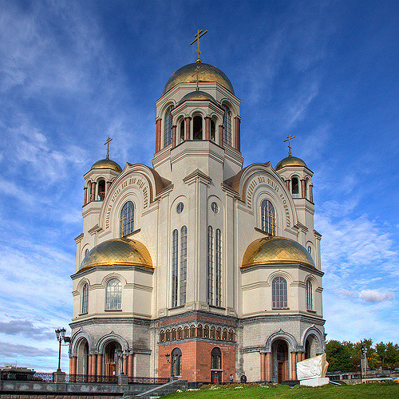
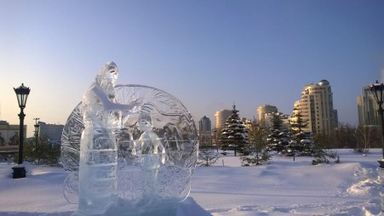
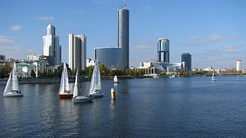
Yekaterinburg, russia
Wonderland Park
Yekaterinburg Port
Church of All Saints

Slide 8
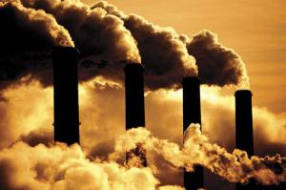
physical
I visited one of the petroleum plants in Russia. It was very neat to see. There was tons and tons of smoke.

Slide 9
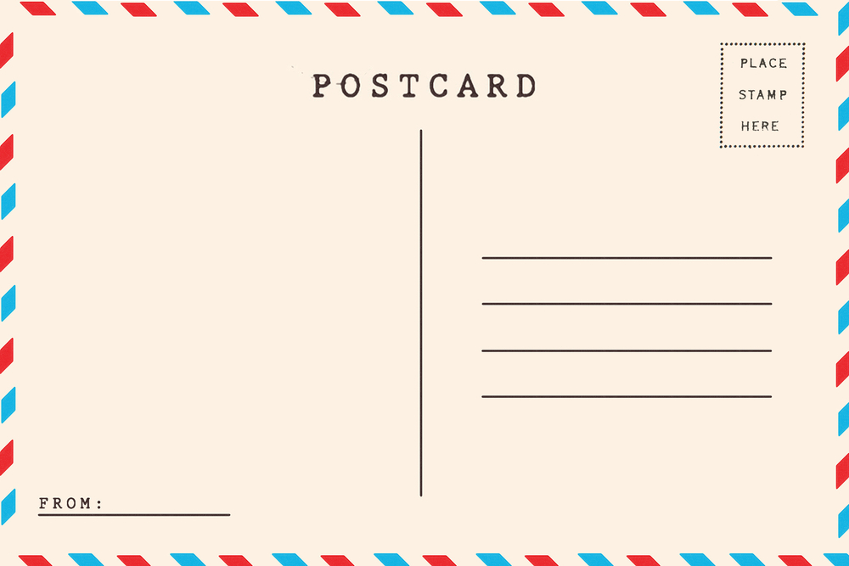
postcard
Dear Payton,
I am having a great time in Russia. I have seen so many cool things. The churches here are amazing. They are huge! Wait for my next letter!
Jeny

