Slide 1
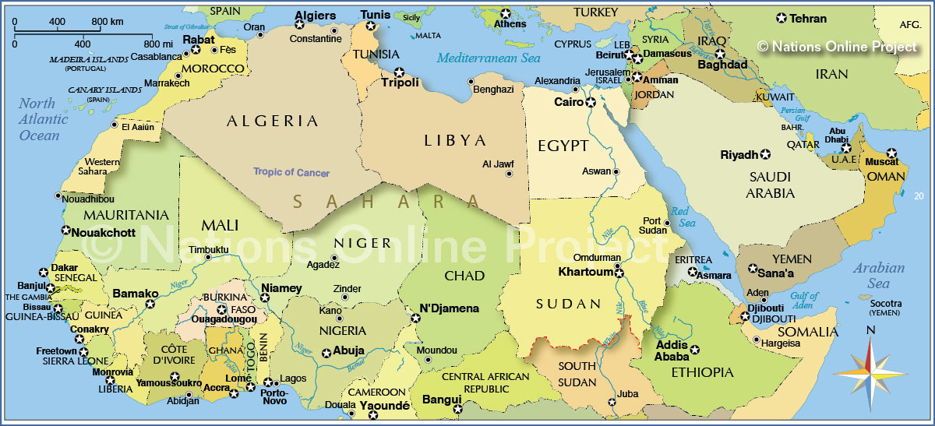
Middle east and north Africa
Political map

Slide 2
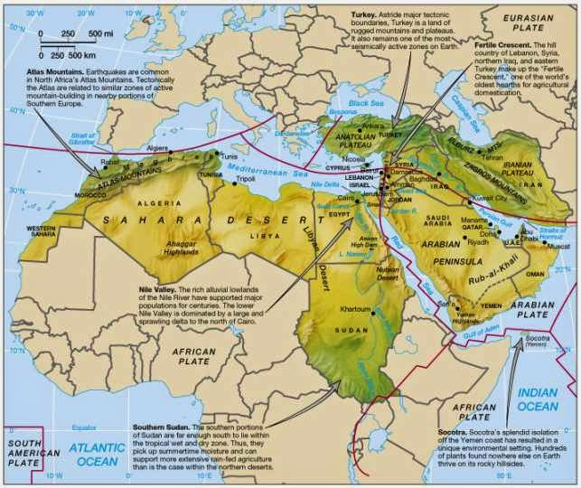
Middle east and north Africa
Physical map
The Middle East region represents an area of over 5.0 million square miles. The physical geography of the Middle East is varied. Vast deserts are common in the region. The Sahara Desert runs across North Africa, essentially limiting settlement to along the Mediterranean coastline and in Egypt along the Nile River.

Slide 3
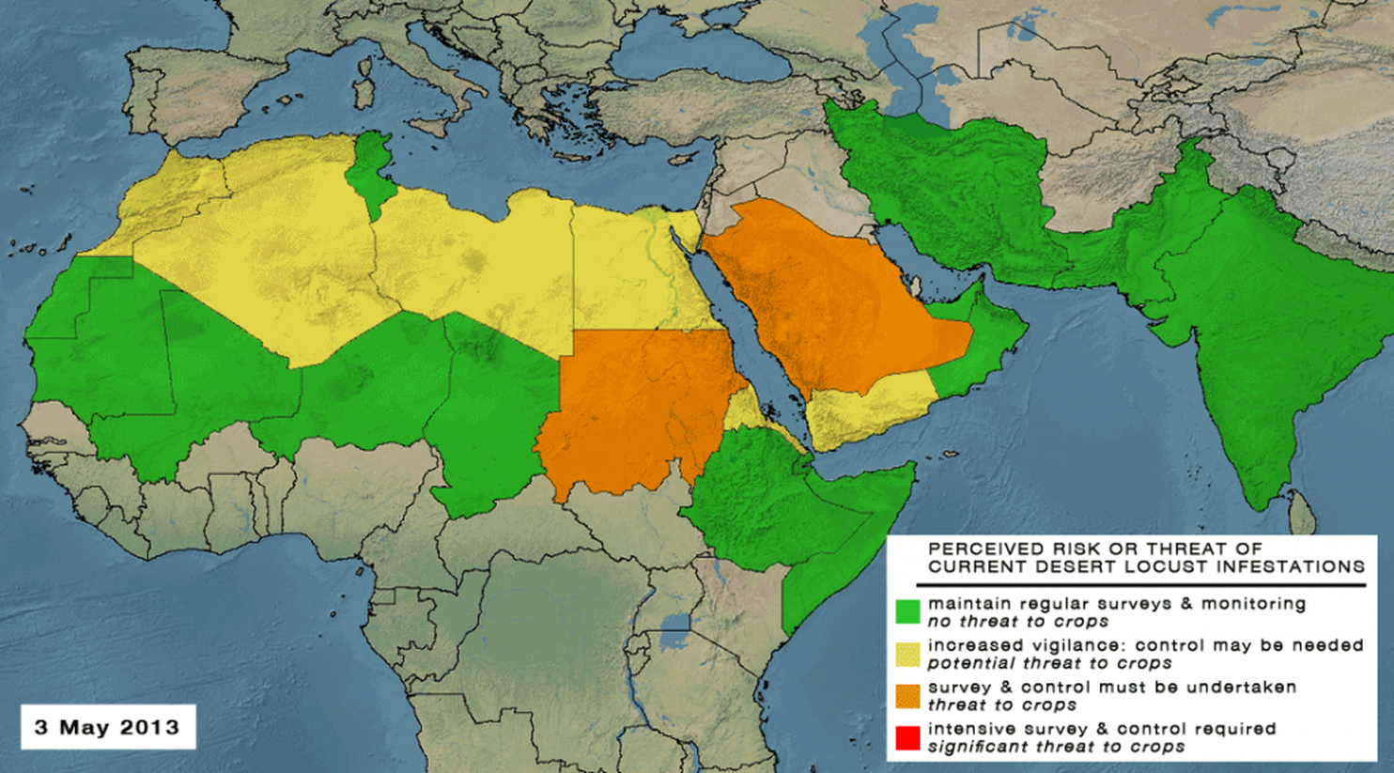
Middle east and north Africa
Climate Map
The Middle East and North Africa could become “uninhabitable” over the course of the 21st Century. They say that the heat is overwhelming.

Slide 4
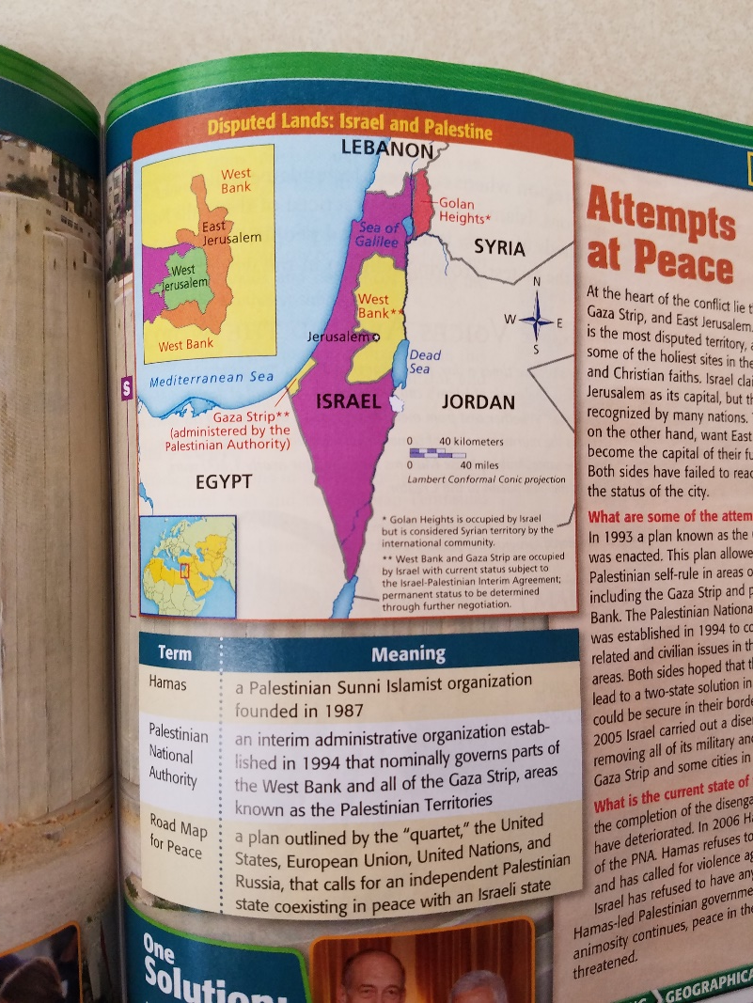
Problems in middle east & north Africa
Israelis and Palestinians each claim the same territory in Southwest Asia. After decades of uprisings, assassinations, attacks, failed peace agreements, and other struggles, conflict remains between these two groups attempting to coexist in the same area. The Israeli soldiers patrol the barrier Israel constructed to protect itself from Palestinian terrorists. Eventually, the barrier will completely separate the West Bank from Jerusalem. Many feel that the only solution may be the creation of an independent country of Palestine. In 2003, George W. Bush called for an independent Palestinian state living in peace with Israel. Most recently, the Road Map for Peace was published as the next step in the peace process.

Slide 5
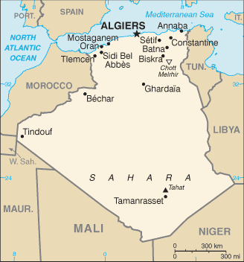
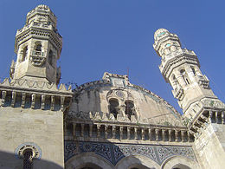
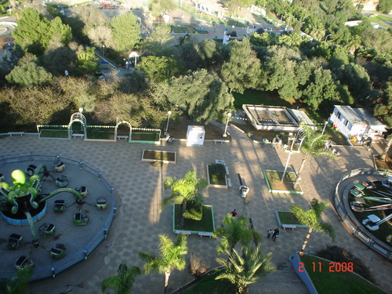
Algeria - Algiers
Ben Aknoun Zoo
Ketchaova Mosque
Martyr’s Memorial

Slide 6
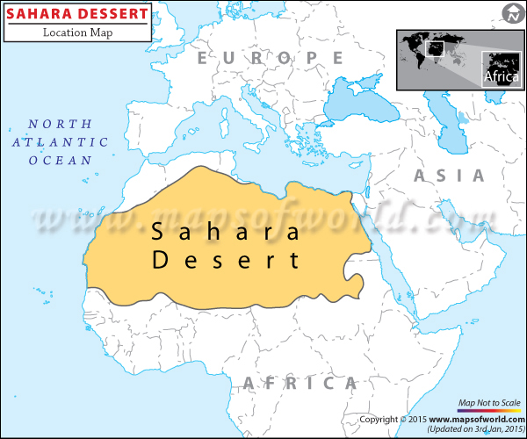
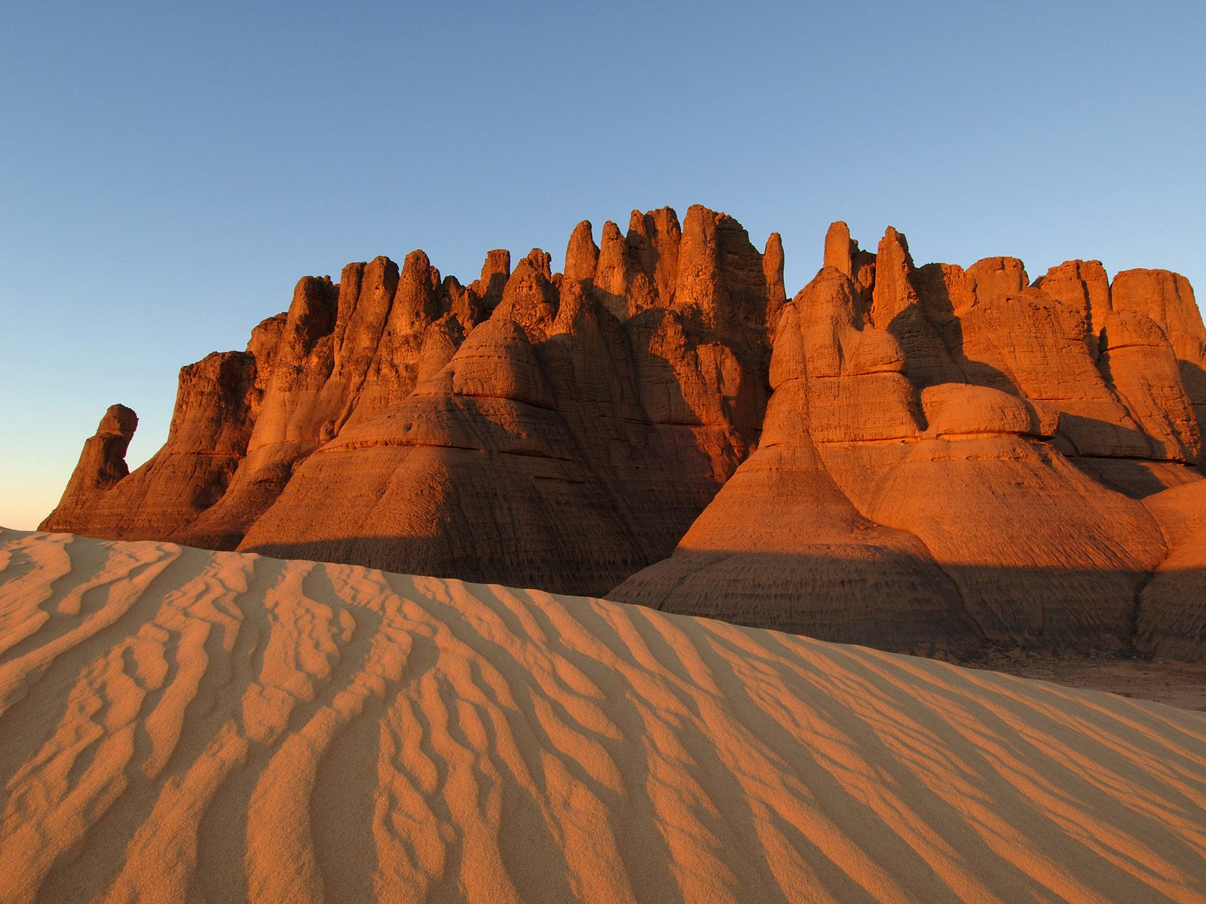
Physical – sahara desert
Sahara Desert

Slide 7
postcard
Dear Payton,
I had a blast in Algeria. The Sahara Desert was very neat to see. It was so hot there. Wish you could be here! My next journey will take me to Mali.
Jeny

Slide 8
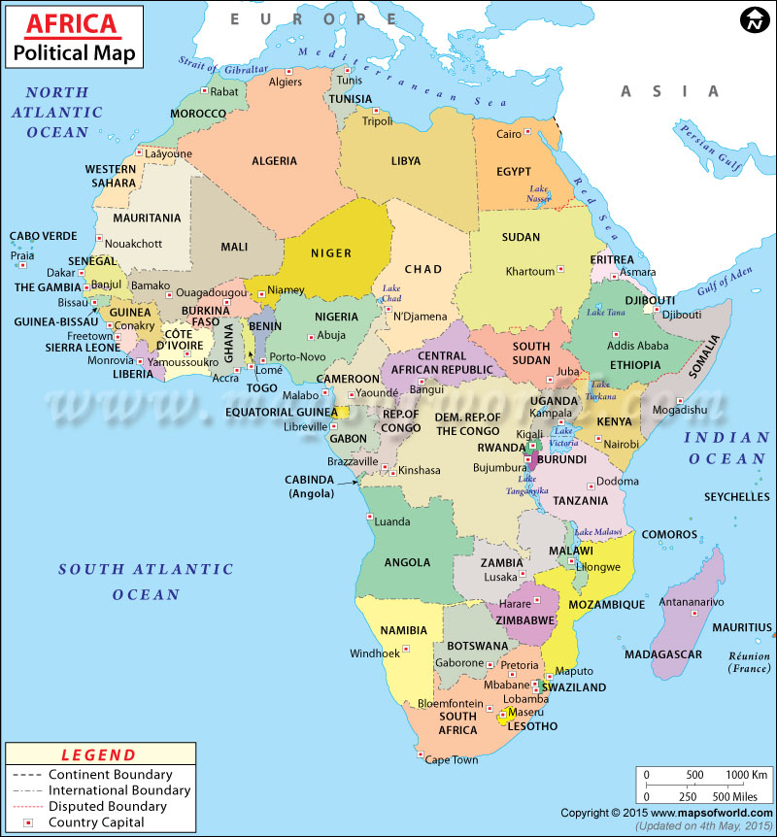
Sub-Saharan Africa
Political Map

Slide 9
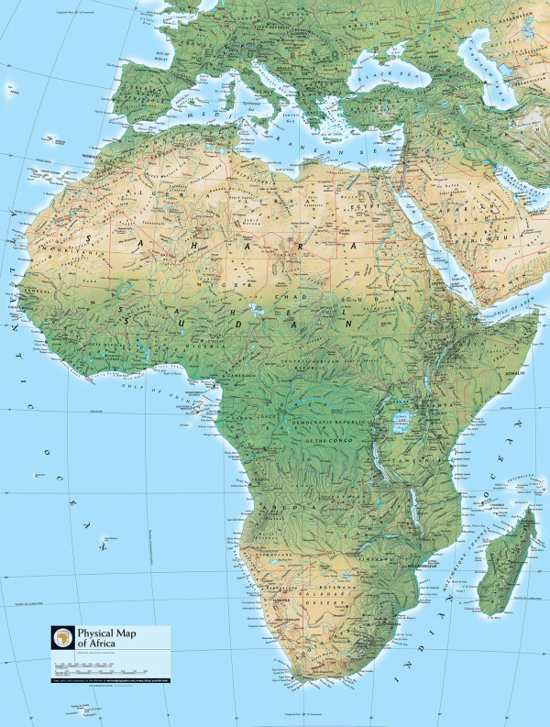
Sub-Saharan Africa
Physical Map
The South Africa's Cape Ranges are low-lying mountains no higher than about 6,000 feet. The continent of Africa consists of basins and plateaus without long mountain chains. The plateaus can range more than 1,000–2,500 feet in elevation. The only continuous feature is the eastern rift valleys.

Slide 10
Sub-Saharan Africa
Sub-Saharan Africa is, geographically, the area of the continent of Africa that lies south of the Sahara. According to the UN, it consists of all African countries that are fully or partially located south of the Sahara. It contrasts with North Africa, whose territories are part of the League of Arab states within the Arab world. Somalia, Djibouti, Comoros and Mauritania are geographically in Sub-Saharan Africa, but are likewise Arab states and part of the Arab world.

Slide 11
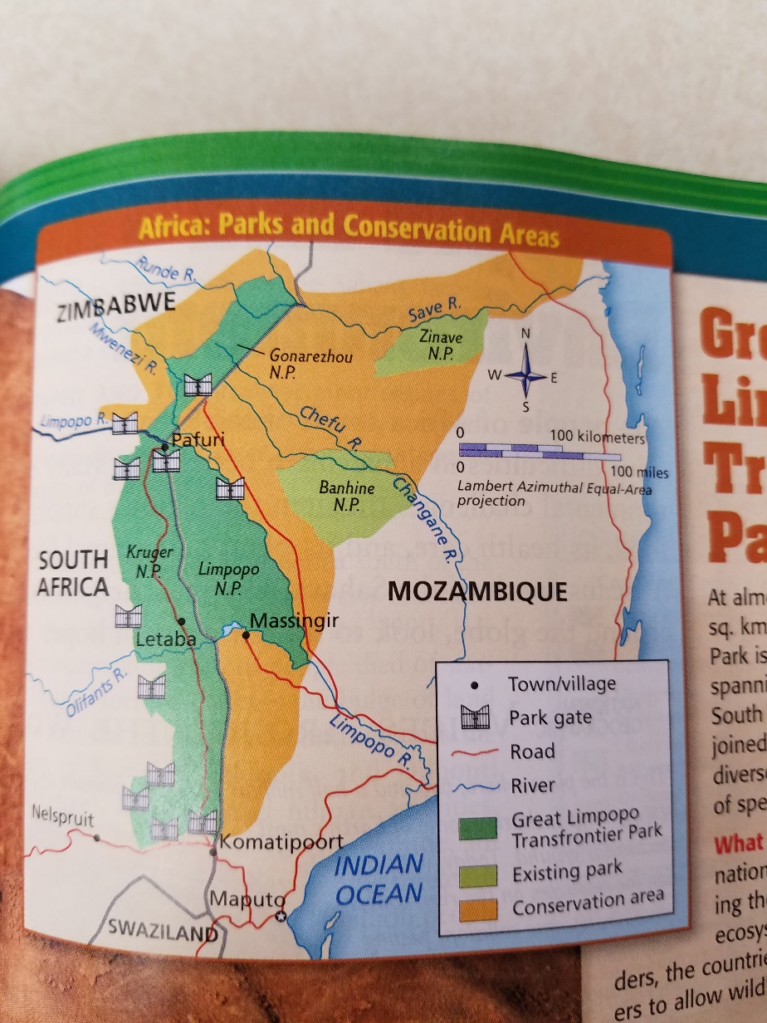
Problems of Sub-Saharan africa
Wildlife conservation is a problem in Africa. Within ten years, rhinos could be extinct in the wild. After 50 million years only five species of rhinos remain, and all are threatened with or on the verge of extinction. Many people poach rhinos because it is profitable for them. Humans seeking shelters from escaping the flood waters destroy wildlife and wildlife habitats. Peace parks bring together these countries. These neighbors cooperatively manage the parks to protect the biodiversity of the region.

Slide 12
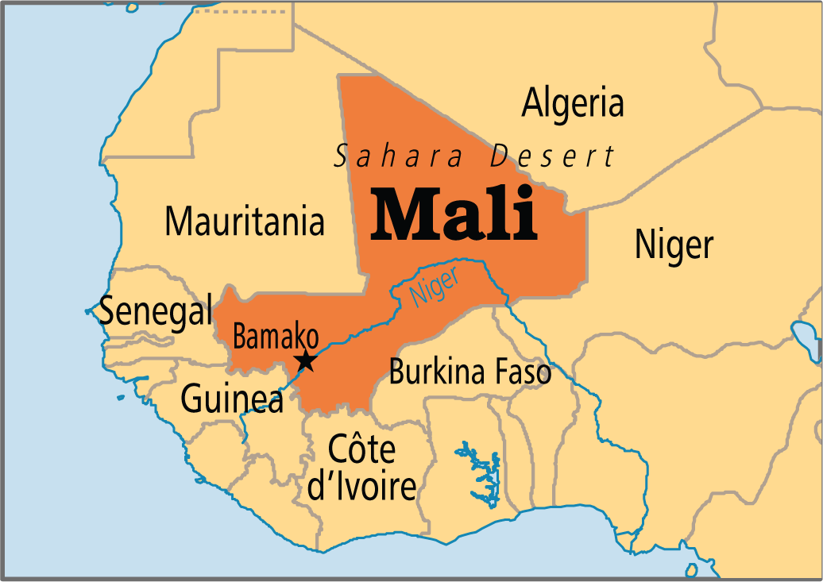
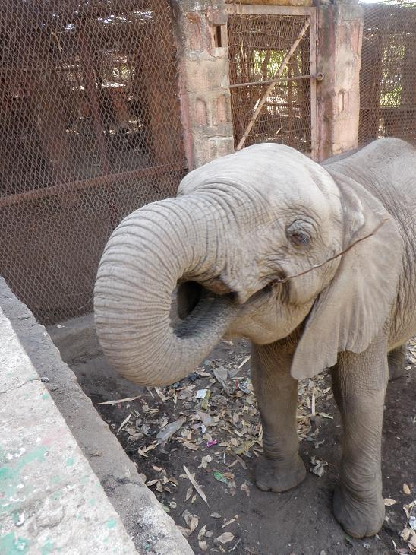
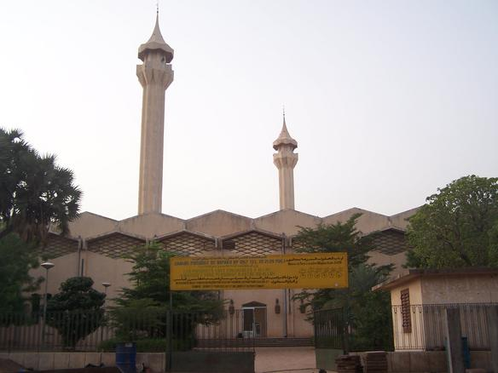
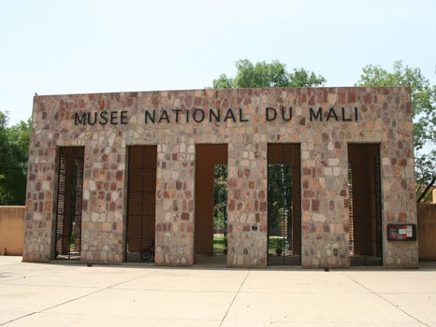
Mali - Bamako
Grand Mosque of Bamako
Bamako Zoo
National Museum of Mali

Slide 13
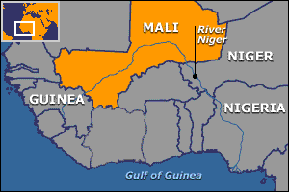
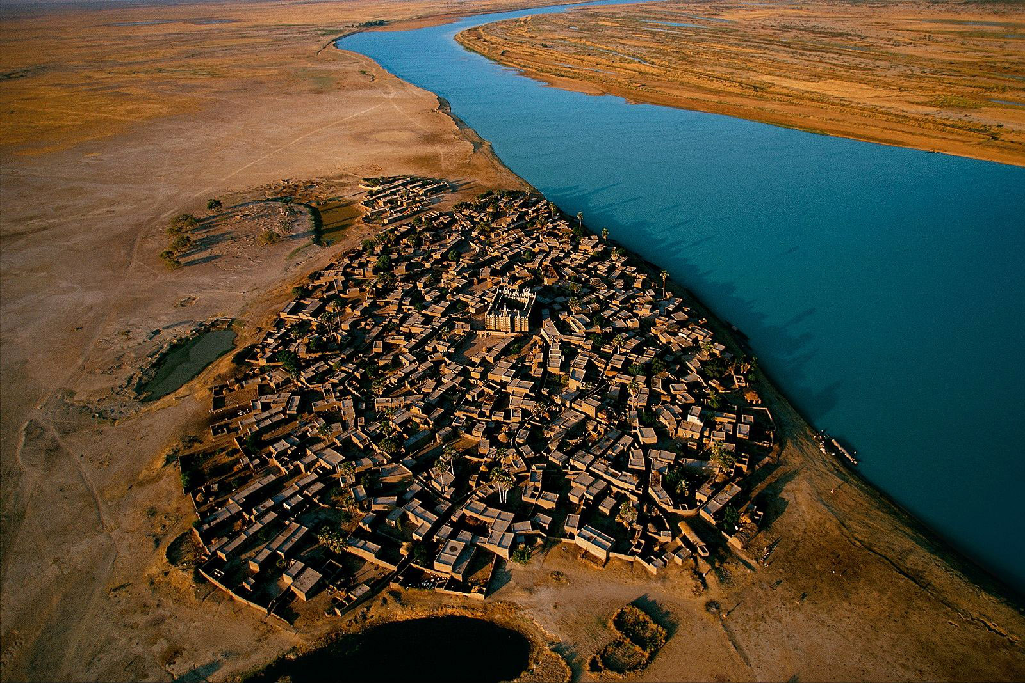
Physical feature of mali – niger River
Niger River

Slide 14
postcard
Dear Payton,
I visited Mali this week. I again had a great time. I visited the zoo, Grand Mosque, and the National Museum. I also went to the Niger River. My next stop is China and Cambodia.
Jeny

