Slide 1
Geography Scrapbook
By: Jeny Johnson

Slide 2
North America
Political Map

Slide 3
North America
Physical Map
North America has many different geographical features. There are mountains to the west and the east of each ocean. The middle of the region is pretty flat.

Slide 4
North america
Climate Map
The climates of North America vary greatly. In the Midwest of the United States, summers are hot and winters are very cold. The farther north you go, the cold it gets. The farther south, the hotter it gets. Also the northeast can get very cold in the winters as well.

Slide 5
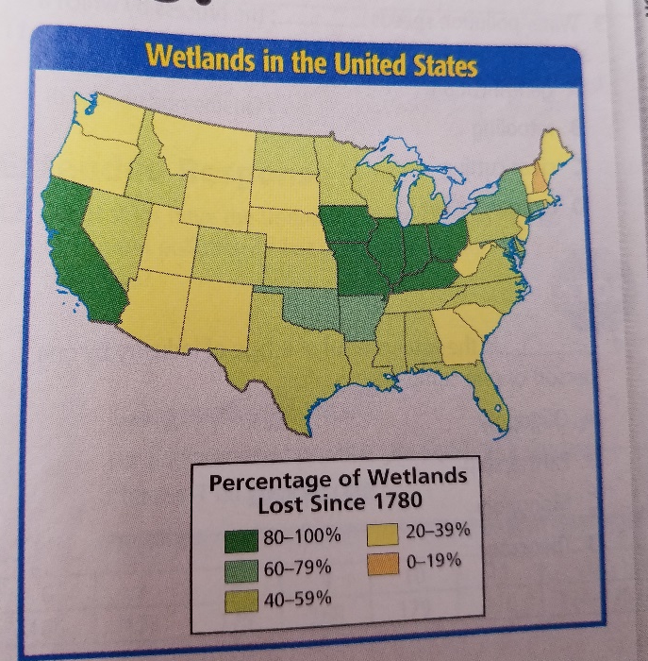
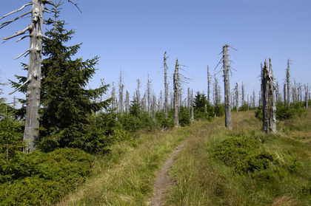
North America
A major problem in North America is an environmental crisis. The US and Canada have mismanaged resources in the past. Pollutants that were released into the air have caused acid rain, smog, and water pollution. New technologies, alternative energy sources, and stricter environmental standards are some ways the United States and Canada are repairing the environment. Many wetlands have been lost because of this.

Slide 6
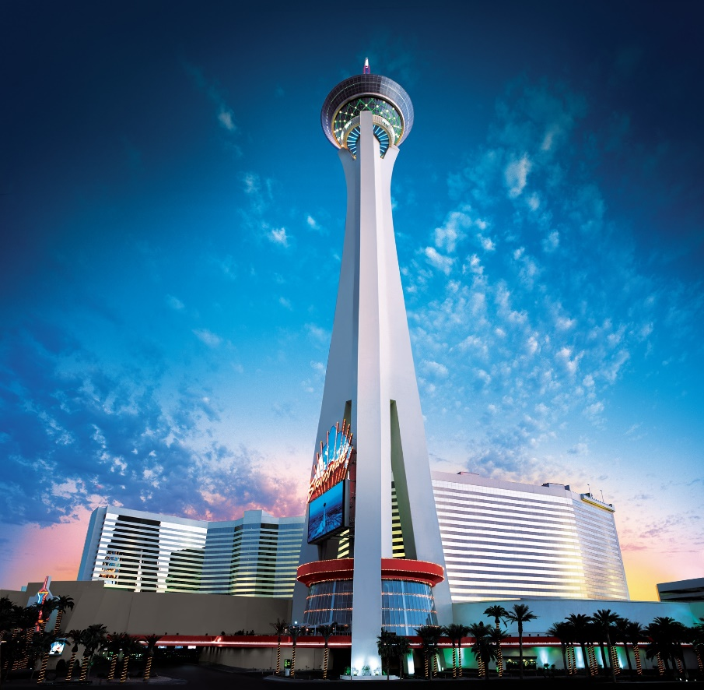
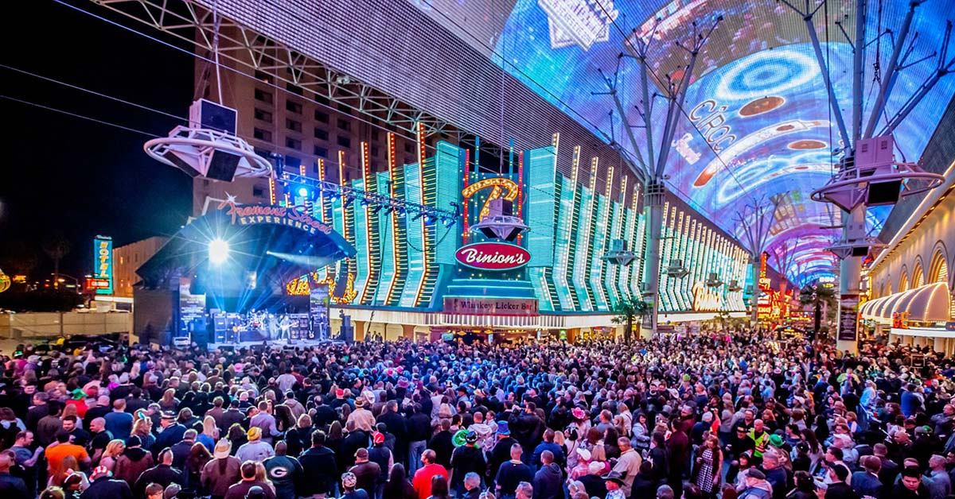
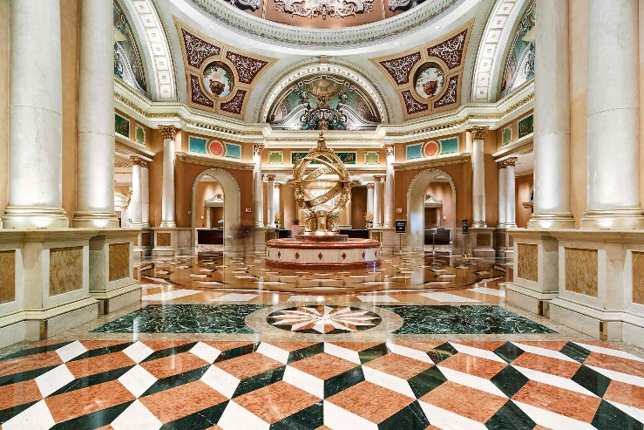
United states - Las vegas
Fremont Street Experience
Stratosphere
Venetian

Slide 7
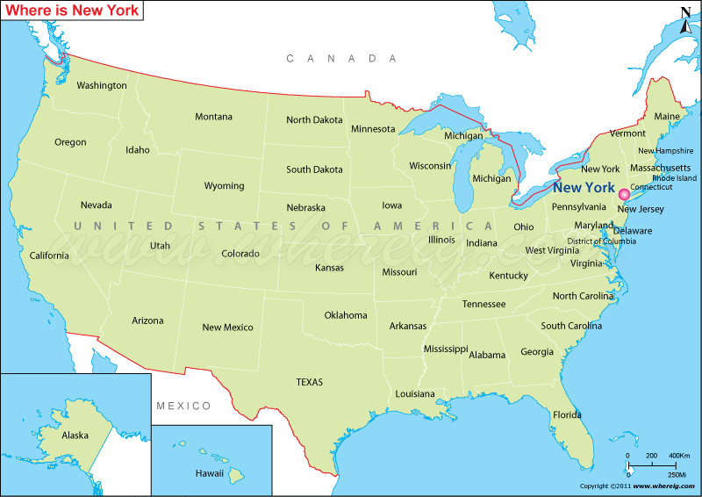
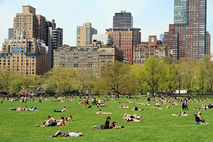
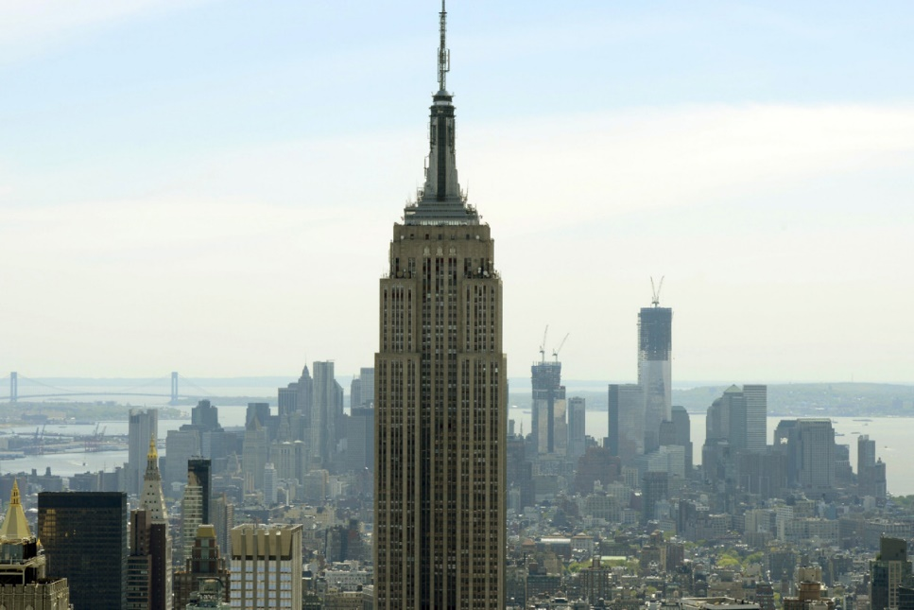
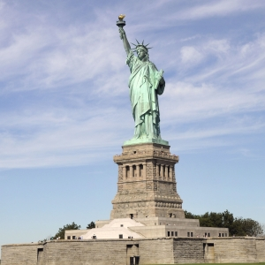
United States - New york
Central Park
Empire State Building
Statue of Liberty

Slide 8
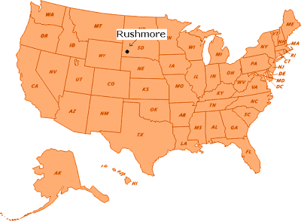
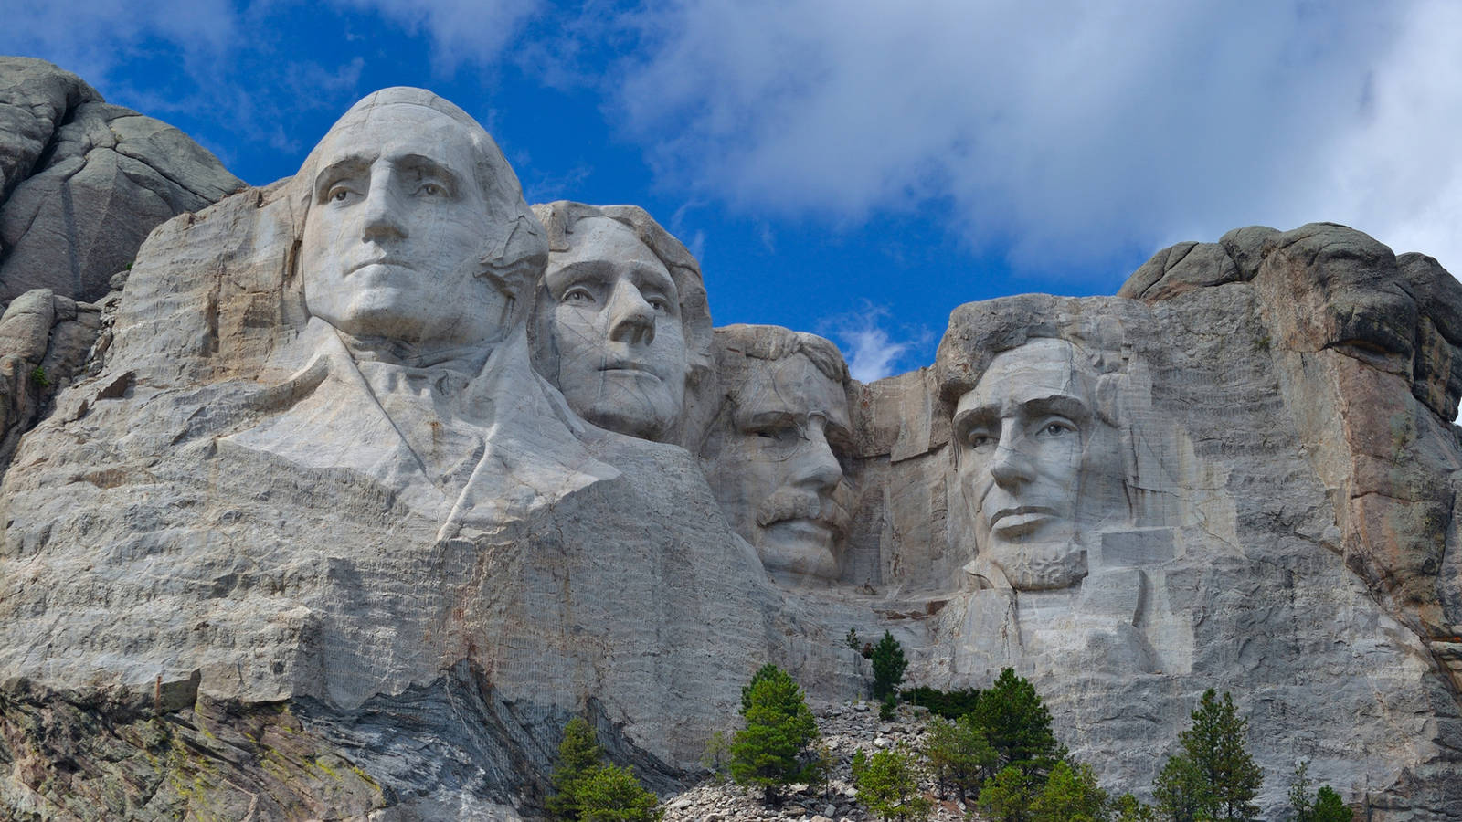
United states - Mount rushmore
Mount Rushmore, Rapid City, South Dakota

Slide 9
postcard
Dear Peyton,
I miss you but I am having a great time. I have visited Las Vegas, New York, and Mount Rushmore. I have seen so many cool things. I wish you were here with me. I’ll write you on my next journey!
Jeny

Slide 10
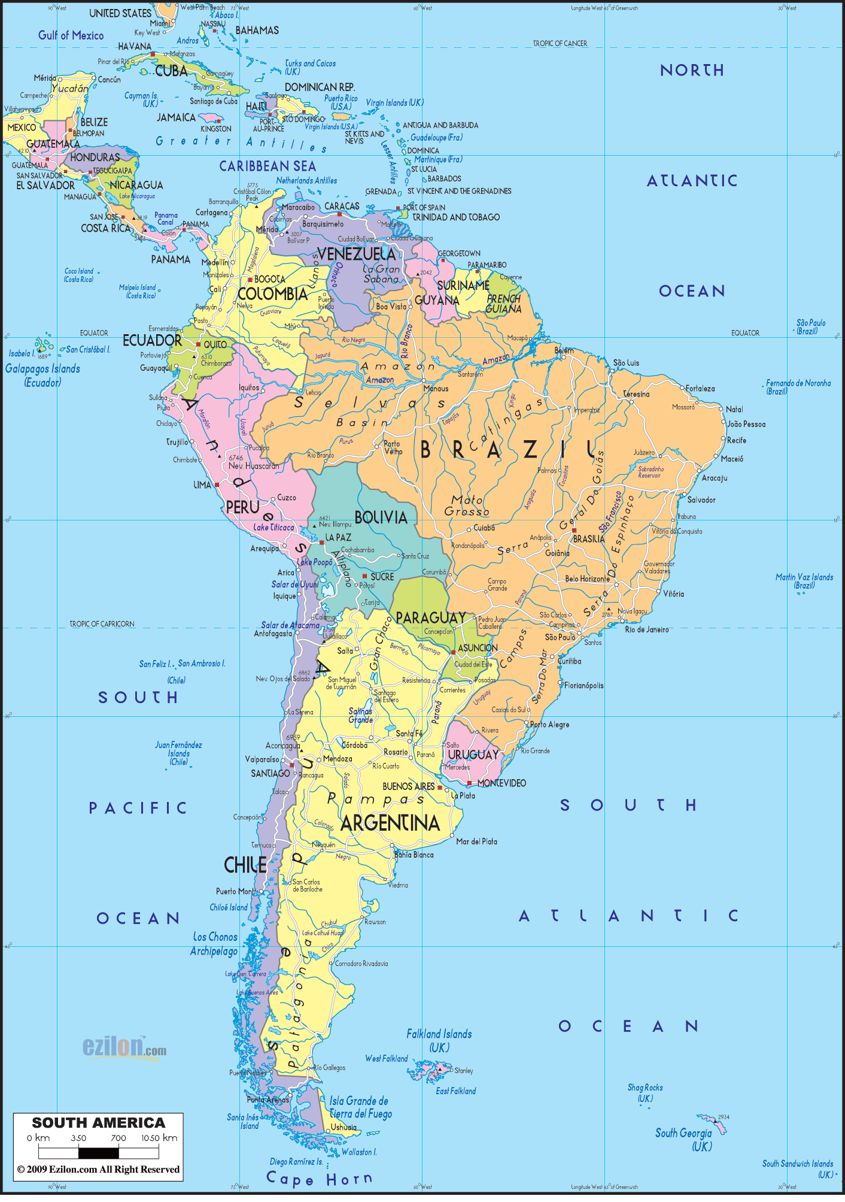
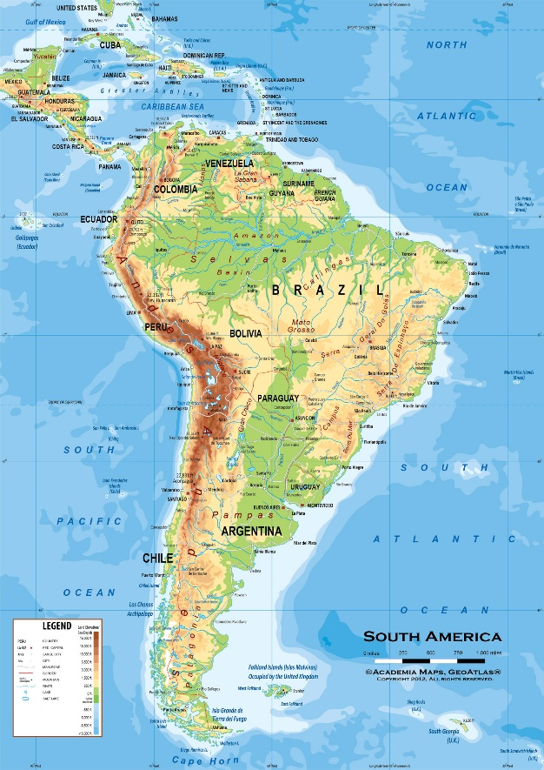
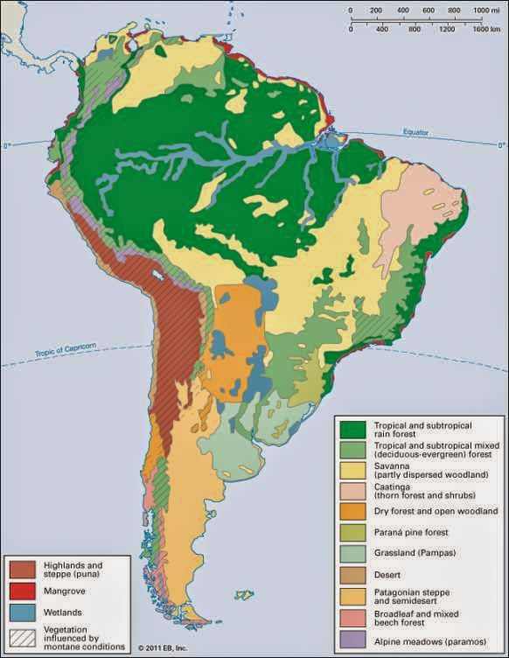
Latin america
Physical Map
South American mountains are dominated by the Andes Mountains. The Amazon River runs through South America. The Pampas grasslands run through Argentina.
Political Map
Climate Map
The climate of Latin America ranges from the hot and humid Amazon River basin to the dry and desert-like conditions of northern Mexico and southern Chile. Rain forest, desert, and savanna are all found in the region. The vegetation varies from rain forests to grass- lands and desert scrub.

Slide 11
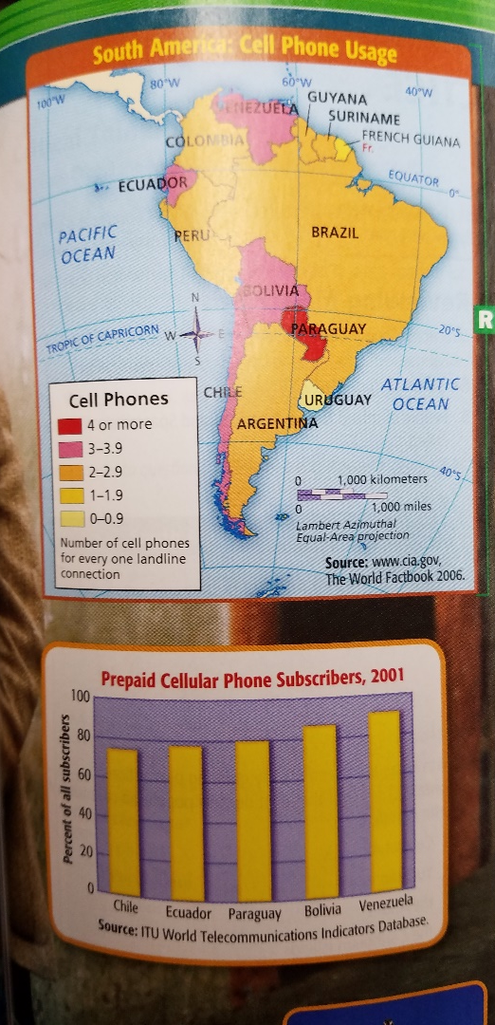
Problems in Latin america
Communications in South America is a problem because the people need an efficient, accessible, and cost-effective network to connect the residents of the region. A lack of those services contributes to the underdevelopment in parts of the region.
Inefficient and Costly: It takes great time and effort to construct the poles and lines necessary to provide landline telephone service. There is added expnse involved I keeping these networks in working order.
Lack of Services: Before the explosion of cell phone technology, communications capabilities were limited in many South American countries.
Solution: Much of South America, like many parts of Africa and Asia, has turned to cell phone technology to enhance the region’s communications capabilities.

Slide 12
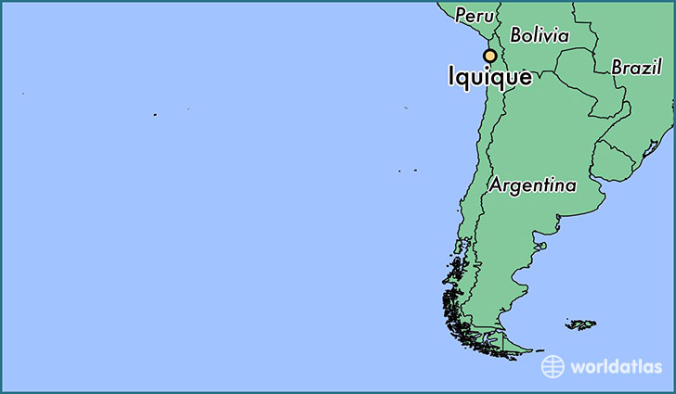
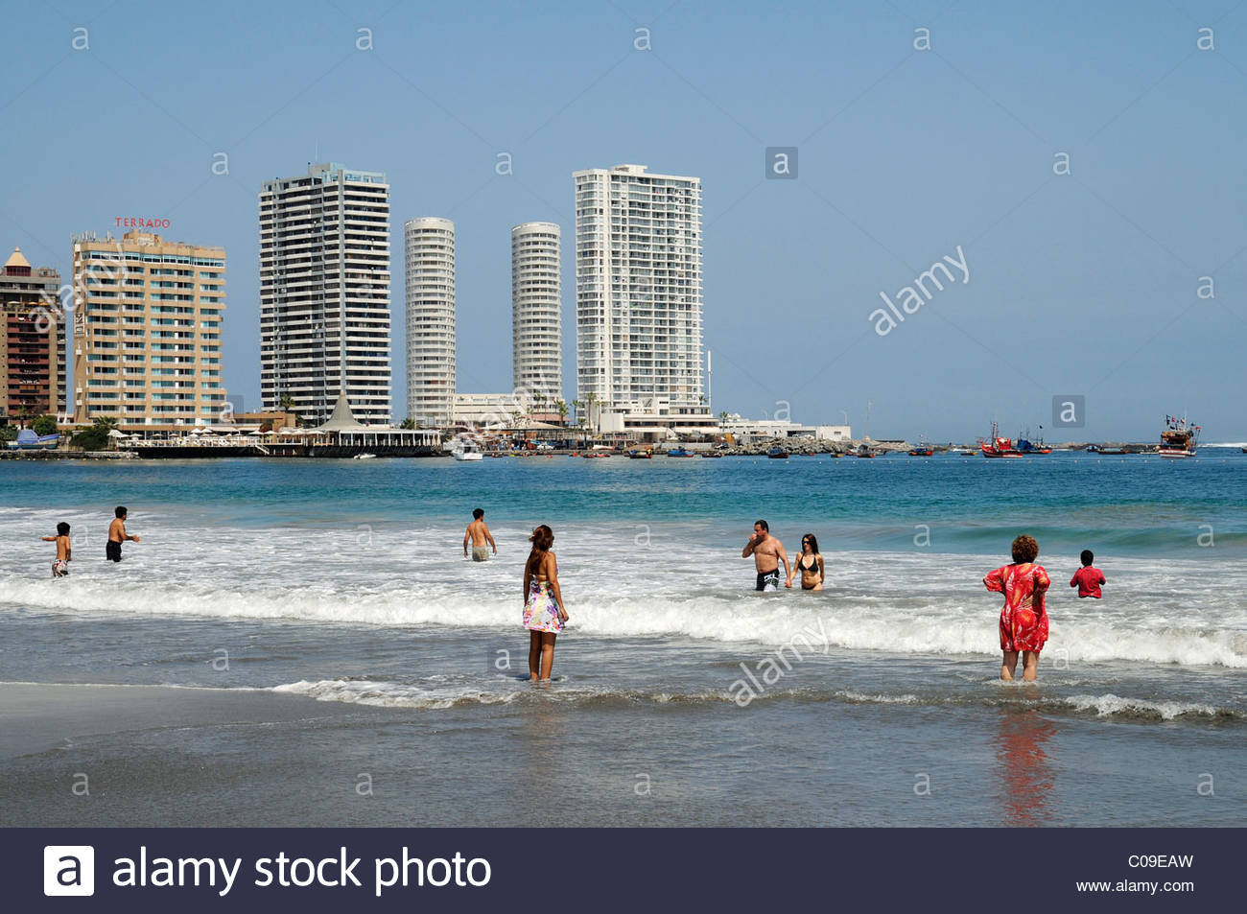
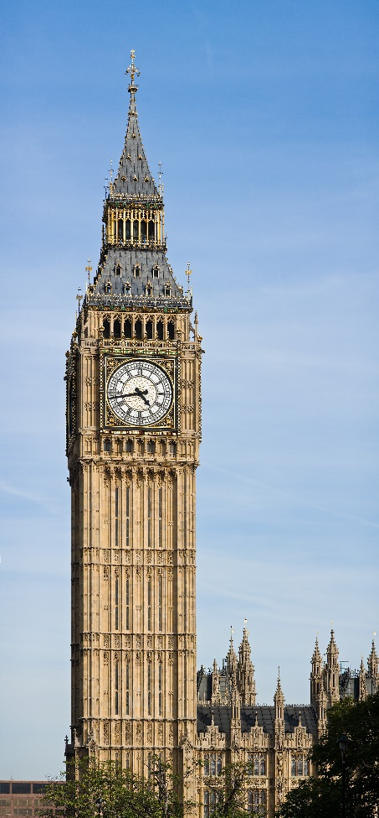
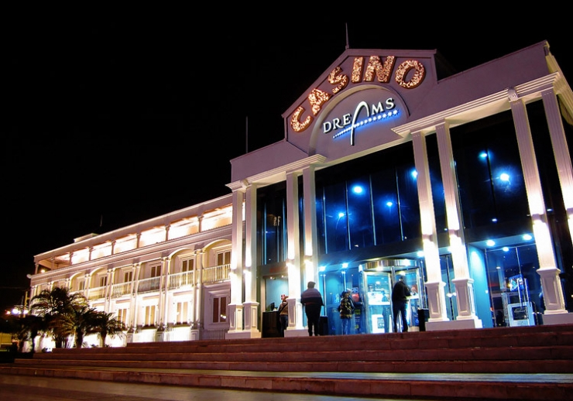
Chile - Iquique
Clock Tower
Playa Cavancha Beach
Dream Iquique Casino

Slide 13
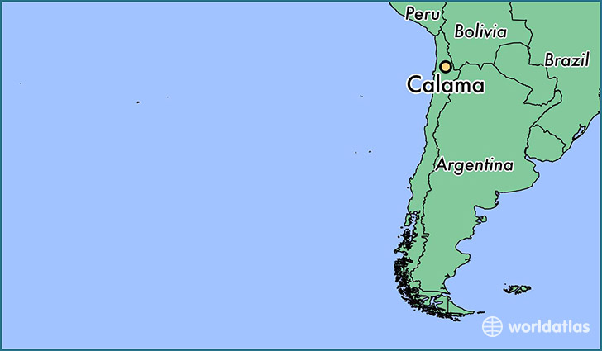
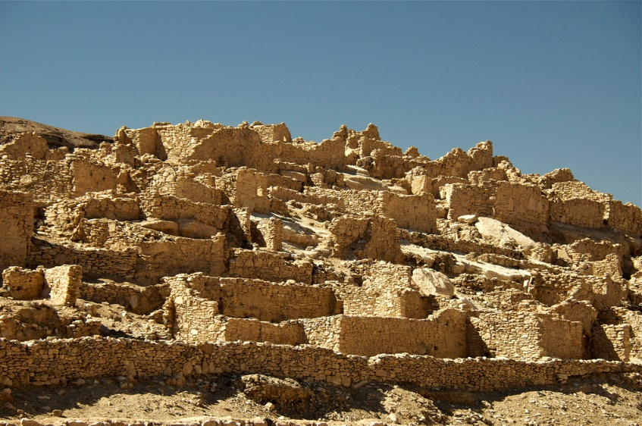
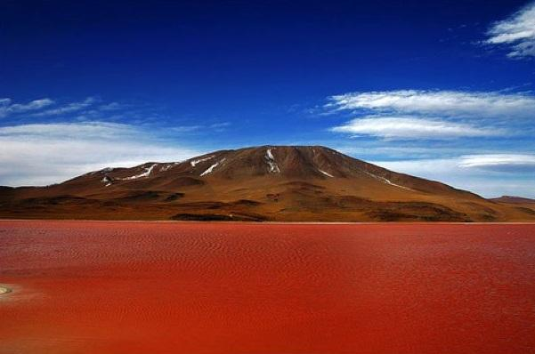
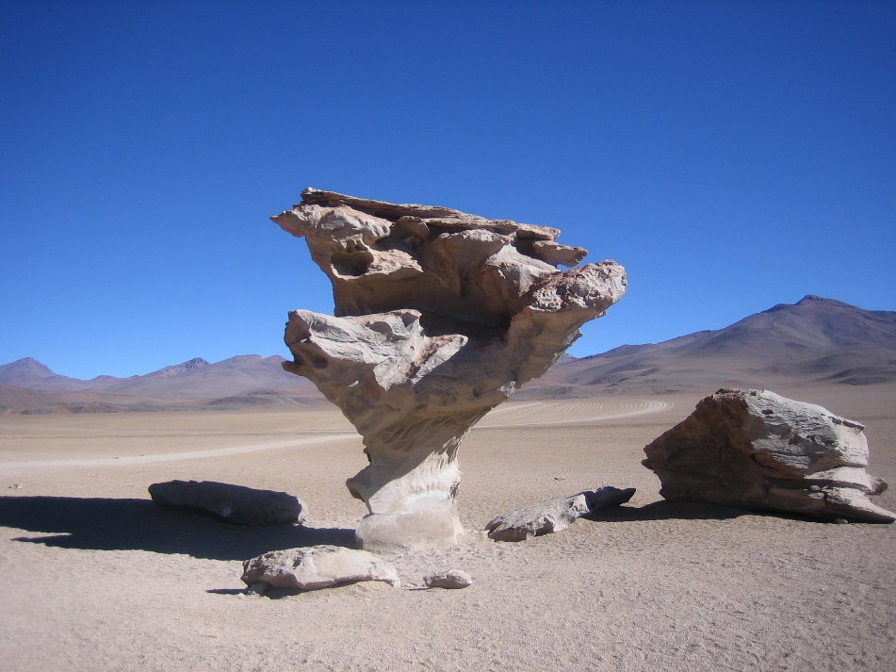
Chile - Calama
Arbol de Piedra
Lasana
Laguna Colorada

Slide 14
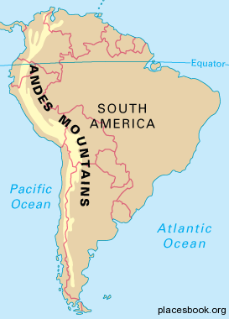
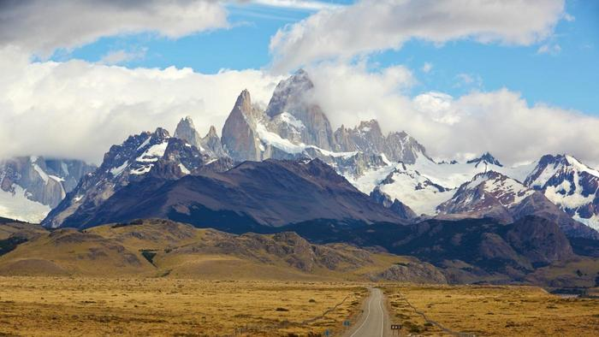
Chile – andes mountains
Andes Mountains

Slide 15
postcard
Dear Payton,
I traveled to Chile this week and boy o boy did I see some really neat things. The Andes Mountains were one of the coolest things I’ve ever seen. The sites I see in Calama were quite neat as well. I can’t wait to show you all my pictures. My next travels will be to Europe!
Love, Jeny

Slide 16
Bolivia
Political Map

Slide 17
Bolivia
Bolivia's western half is covered by the Andes, as three meandering high mountain chains dominate the landscape. The eastern slopes of the Cordillera Oriental descend gently into rolling hills; numerous rivers flow eastward here, forming long narrow valleys.

Slide 18
Bolivia
In general the climates in Bolivia are dictated mostly by altitude not latitude. ... There are basically five separate climatic regions: The Andes and Altiplano, the Yungas and Chapare, the temperate valleys, the Chaco and the tropical lowlands of the upper Amazon basin.

Slide 19
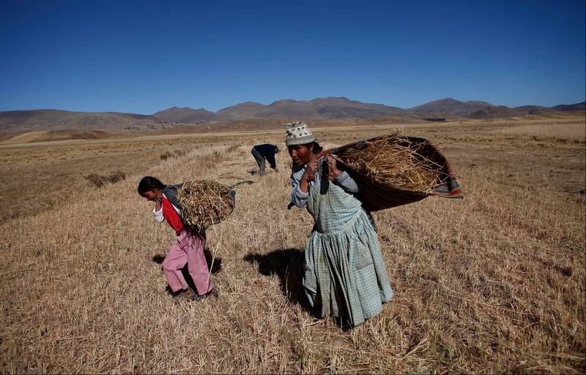
Problems in Boliva
According to the CIA, the most pressing environmental issues in Bolivia are “the clearing of land for agricultural purposes and the international demand for tropical timber are contributing to deforestation; soil erosion from overgrazing and poor cultivation methods

Slide 20
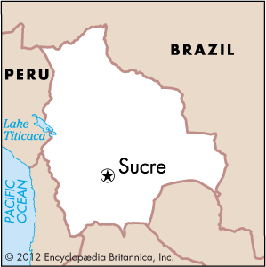
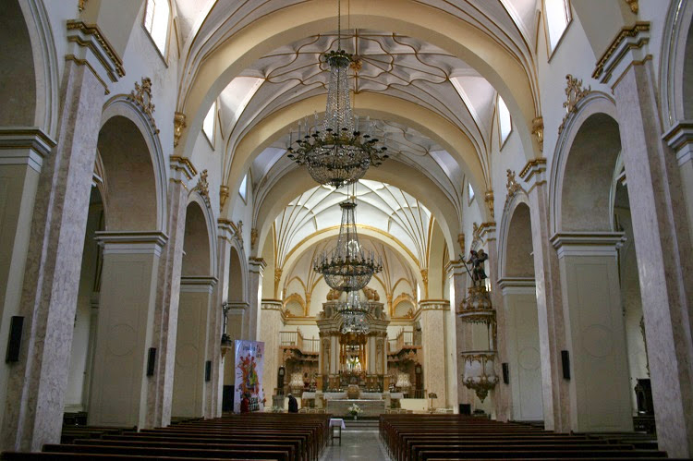
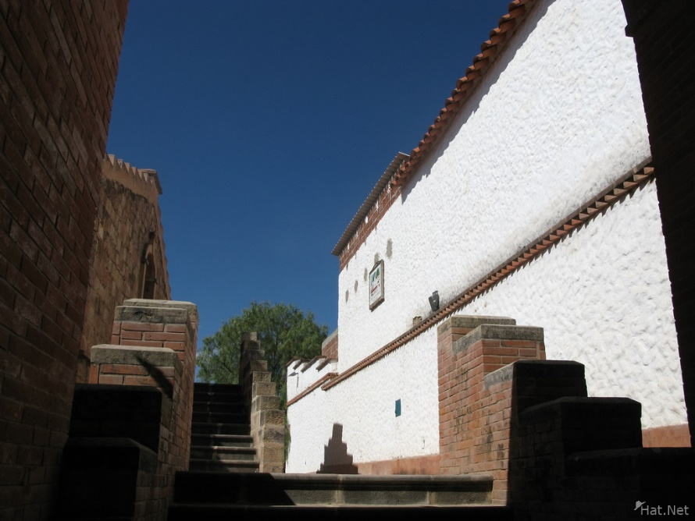
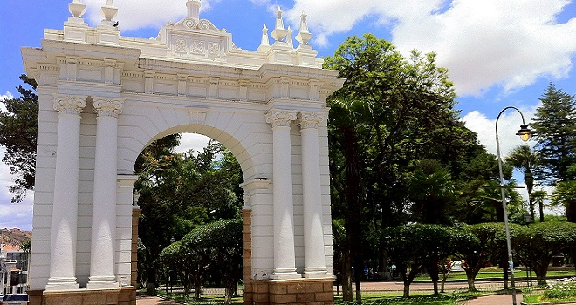
Boliva - sucre
Parque Bolivar
Tanga Tanga
Sucre Cathedral

Slide 21
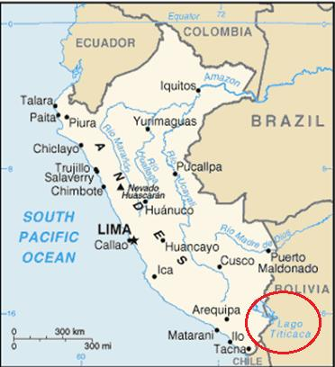
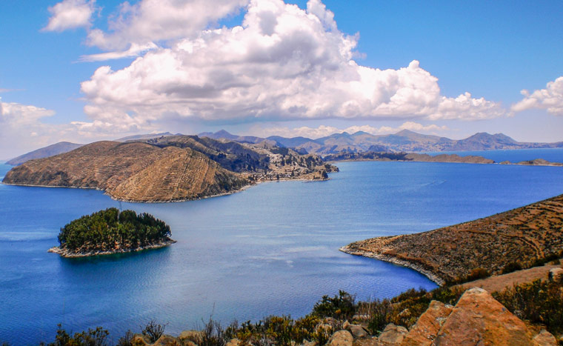
Boliva – lake titicaca

Slide 22
postcard
Dear Payton,
I’m finally coming home. My journey has come to an end. I had a great time in Bolivia too. Lake Titicaca was my favorite place. It was beautiful. We should go there together sometime! I will see you soon!
Jeny

