Slide 1
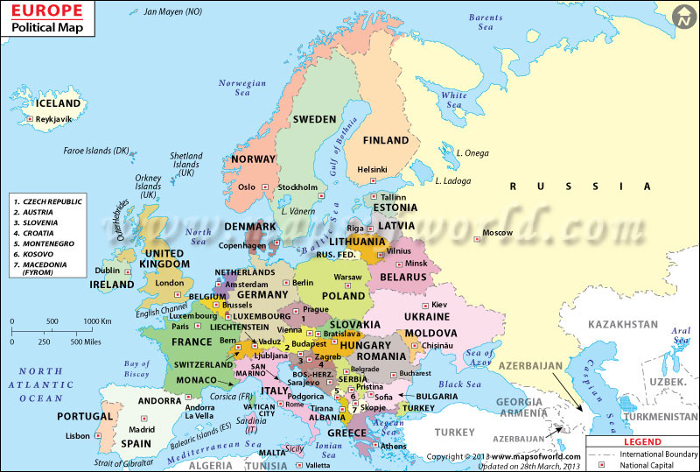
Europe
Political Map

Slide 2
Physical map of Europe
This region is sparsely populated except in the Rhine, Rhne, Elbe, and Danube river valleys. The Alpine Mountains include ranges in the Italian and Balkan peninsulas, northern Spain, and southern France. The region includes the mountains of the Alps, Pyrenees, Apennines, Dinaric Alps, Balkans, and Carpathians.

Slide 3
Climate in Europe
Europe lies in the northern temperate climate zone. Much of far western Europe is classified as a Oceanic climate, far southern Europe is a Mediterranean climate in the south, and eastern Europe is classified as Continental climate. ... Parts of the central European plains have a hybrid oceanic/continental climate.

Slide 4
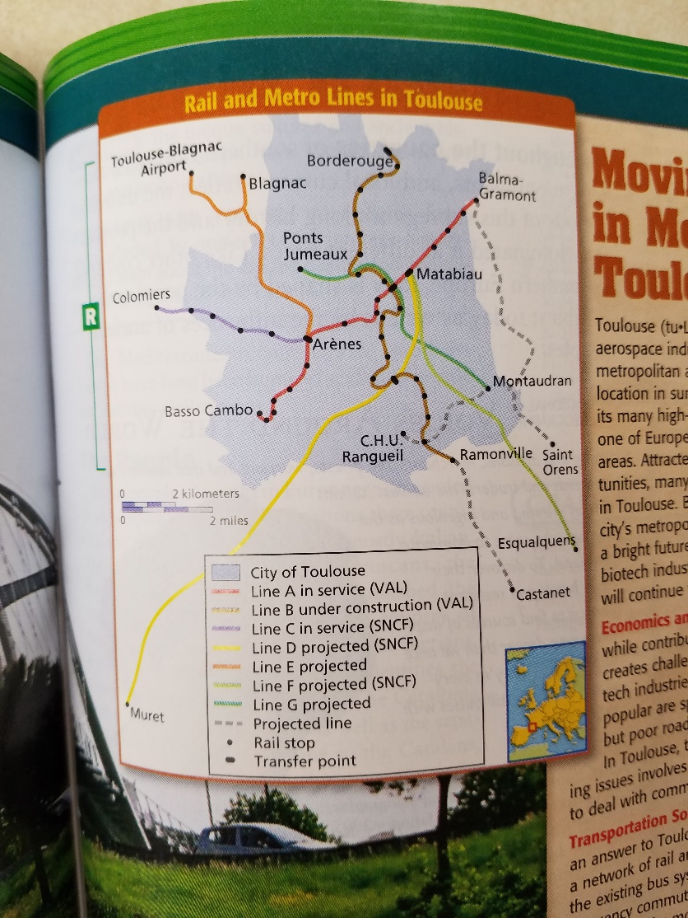
Problems in Europe
One problem in Europe is the urban growth and transportation. Rapid population growth and an inadequate transportation network have caused problems for the commuters of metropolitan Toulouse. There was a population boom and the promise of jobs in the industries of Toulouse has drawn people to the area over the last several decades. The rapid growth led to increased road traffic. This traffic made travel around the city difficult. There was one possible solution to the problem was in 1993, the first driverless metro, Line A, opened in Toulouse. Additional lines have been opened since then and many more are in the development and planning stages.

Slide 5
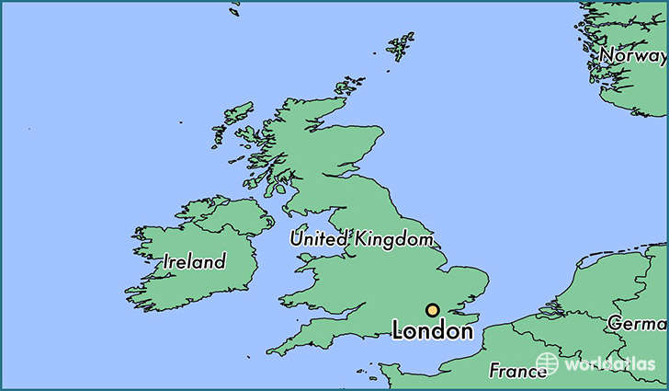
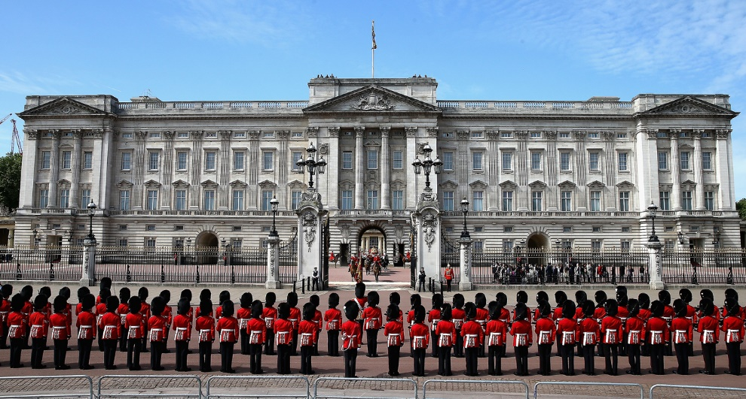
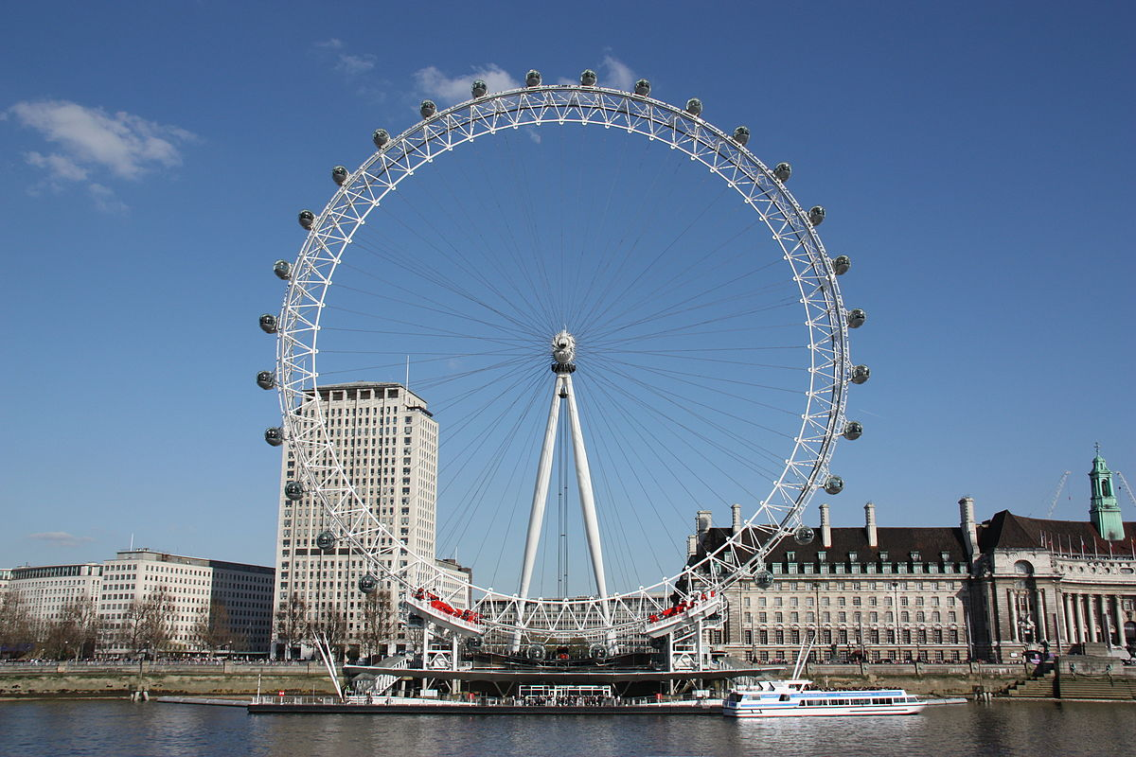
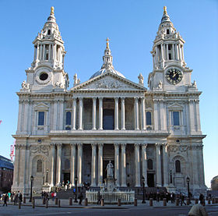
United kingdom – London
London Eye
St. Paul’s Cathedral
Buckingham Palace

Slide 6
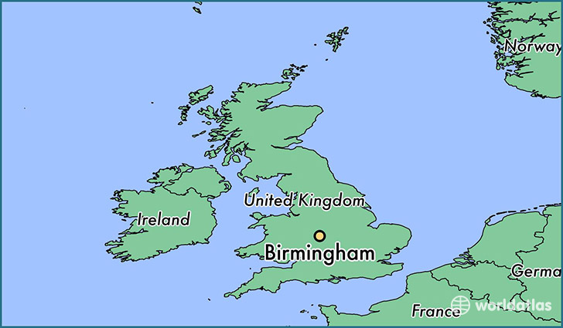
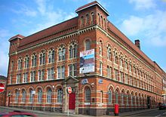
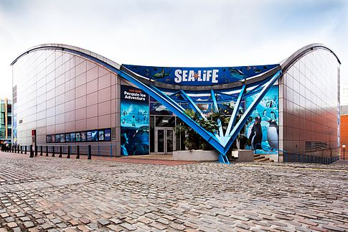
United kingdom – Birmingham
National Sea Life Centre
Cadbury World
Pen Museum

Slide 7
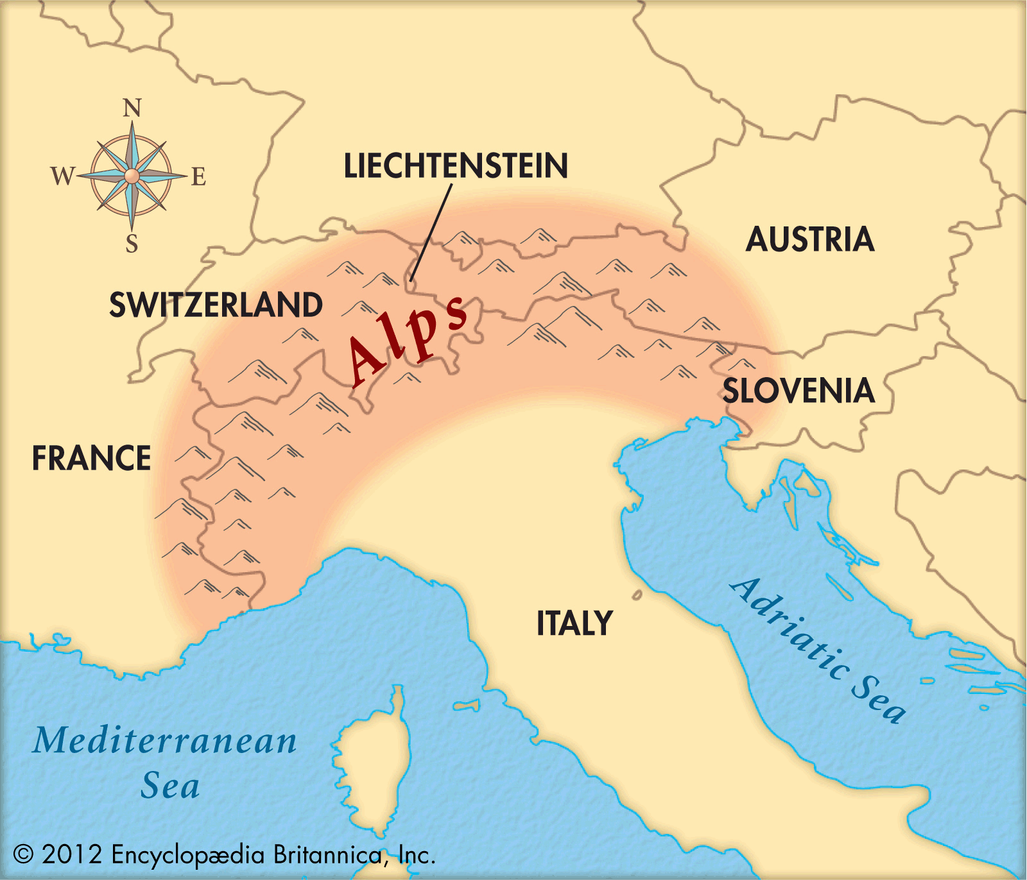
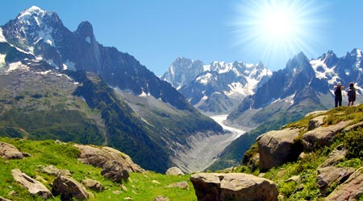
Physical – The Alps
The Alps

Slide 8
postcard
Dear Payton,
I’m having a great time in Europe. I went to London and Birmingham. I also visited the Alps Mountains. It was very cold there. My next journey is onto Russia. Talk to you soon.
Jeny

