Slide 1
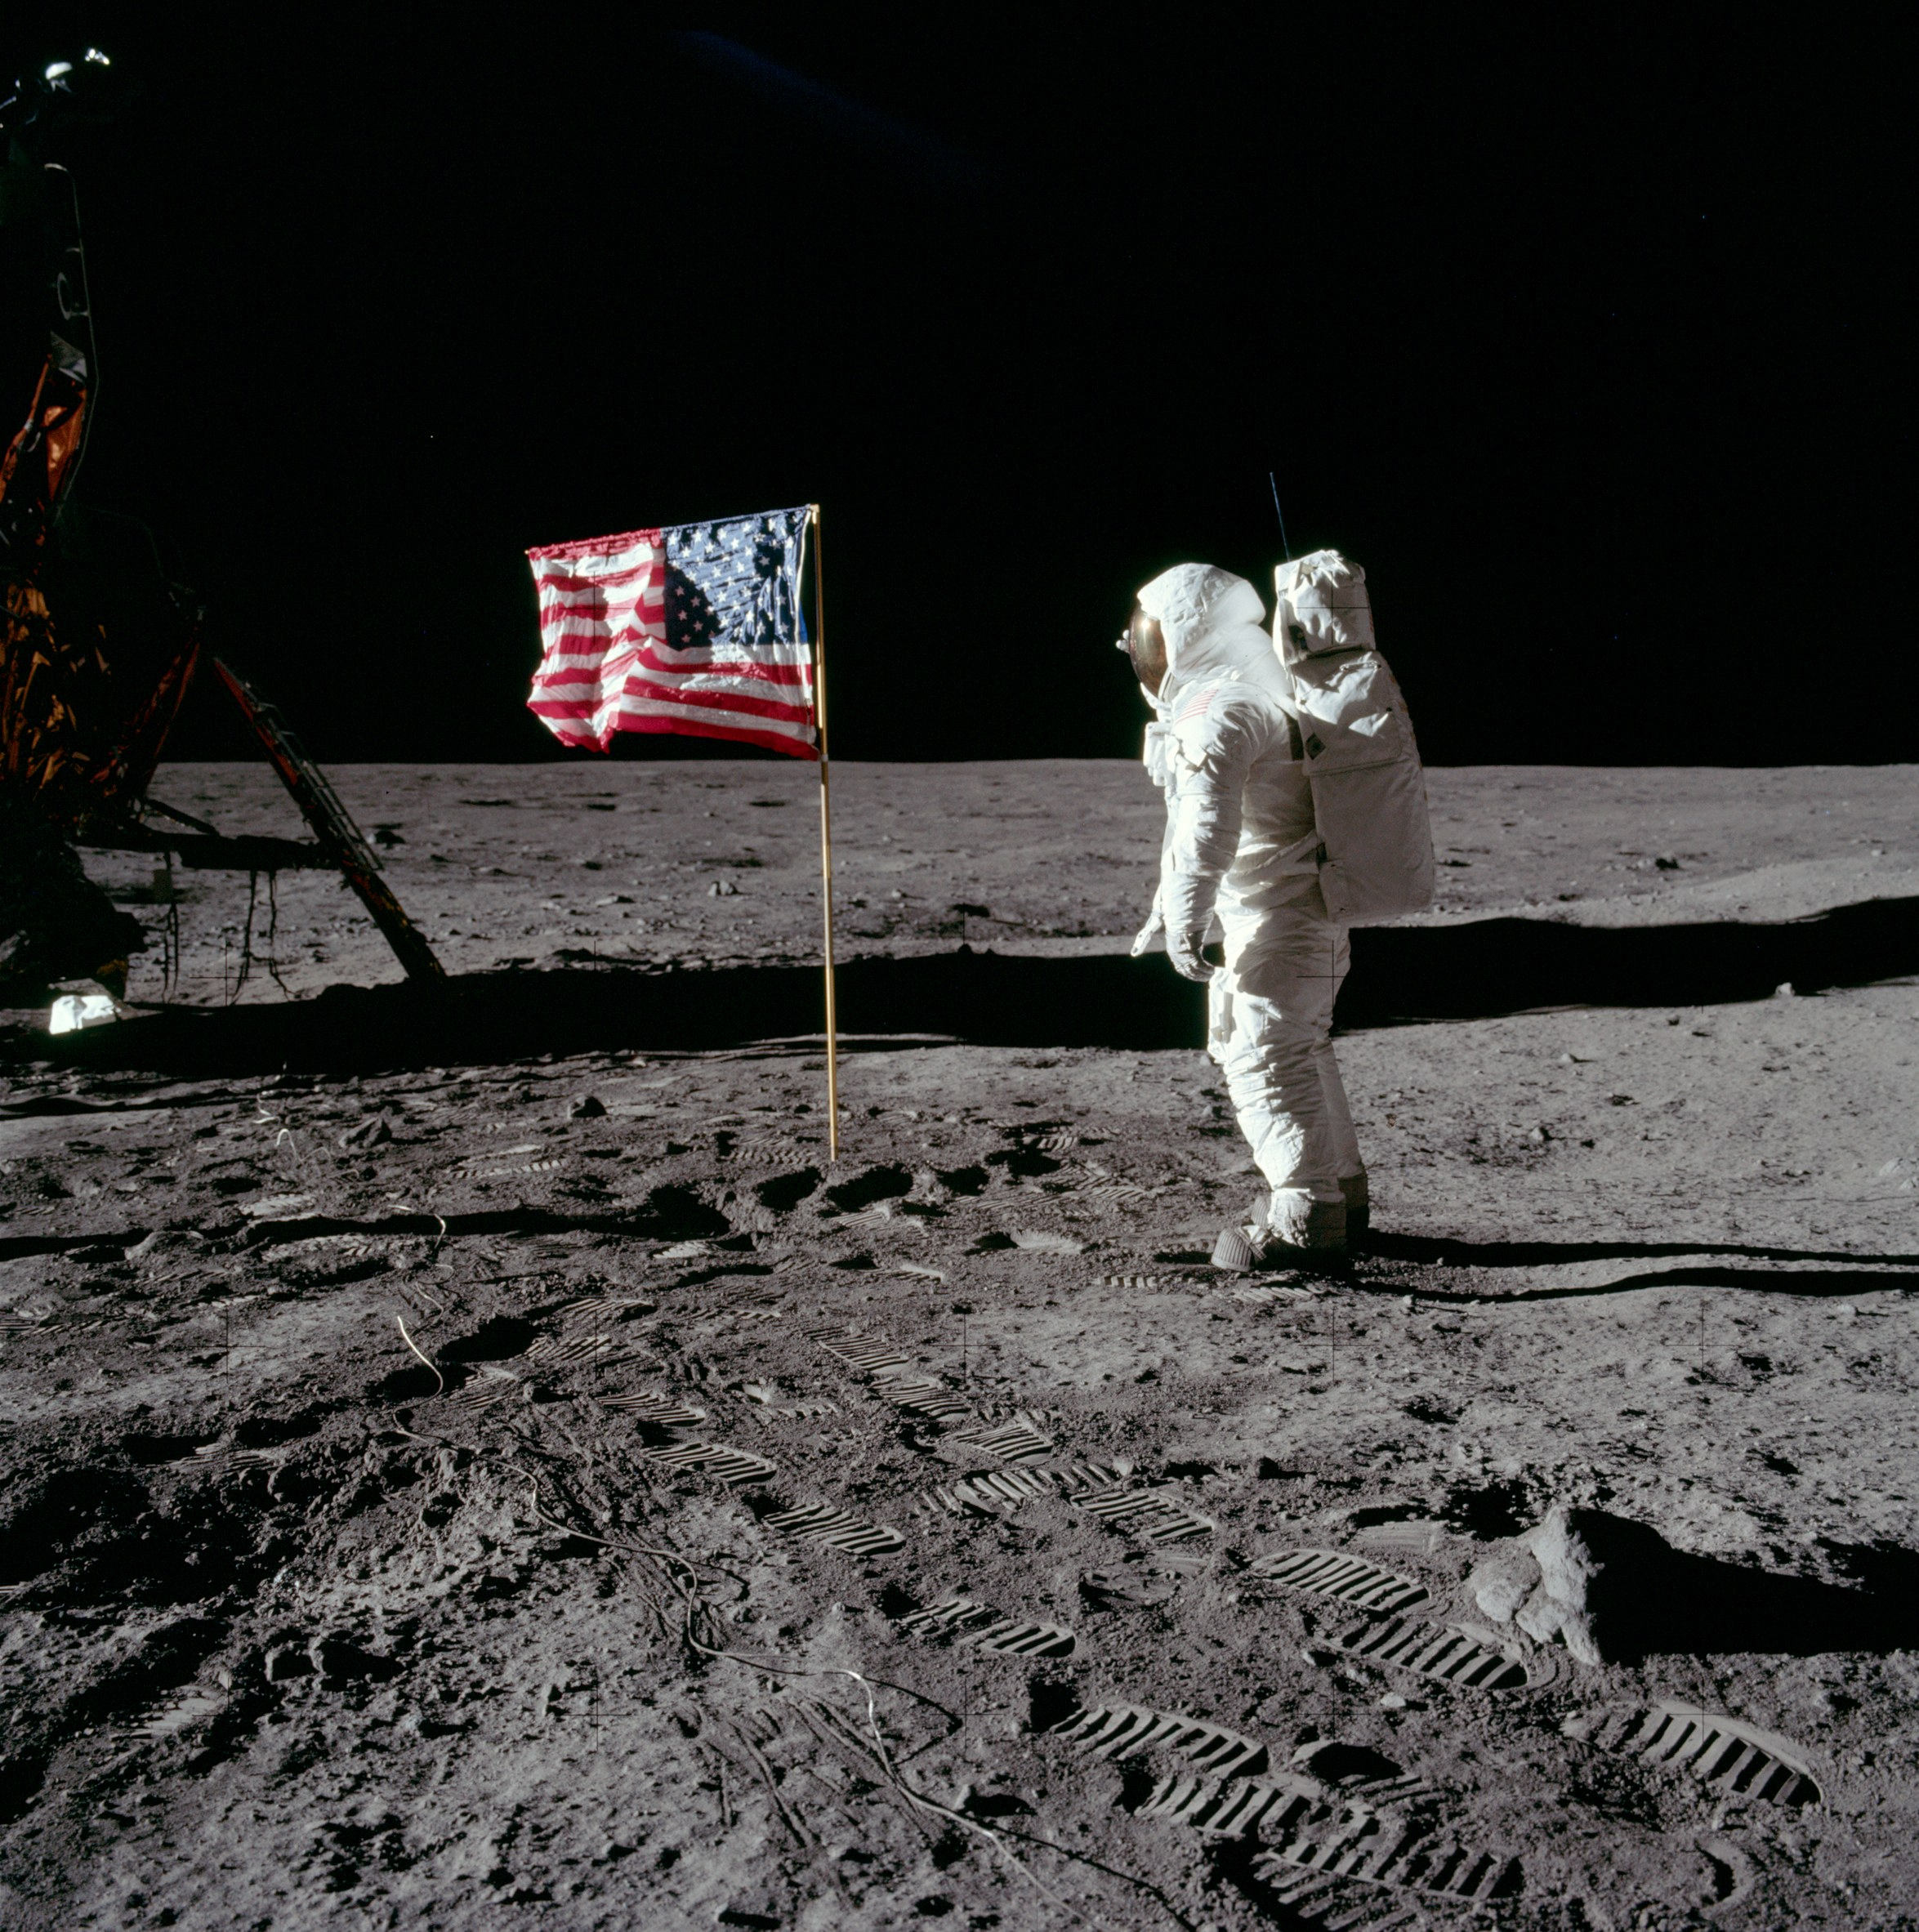
Chapter 24- the new frontier and the great society
In the picture, it shows astronaut Neil Armstrong walking on the moon after placing the American Flag in the ground. He was the very first person to walk on the moon. President Kennedy wanted to make sure that the U.S. was the very first country to land on the moon, and he achieved that goal. He mainly wanted to make sure that the U.S. beat the Soviet Union on the moon to show that the U.S. was, in some way, better.
NASA. “July 20, 1969: One Giant Leap For Mankind.” NASA. https://www.nasa.gov/mission_pages/apollo/apollo11.html (accessed on May 10, 2017).

