Slide 1
Agents of Socialization Project
By: Jeny Johnson

Slide 2
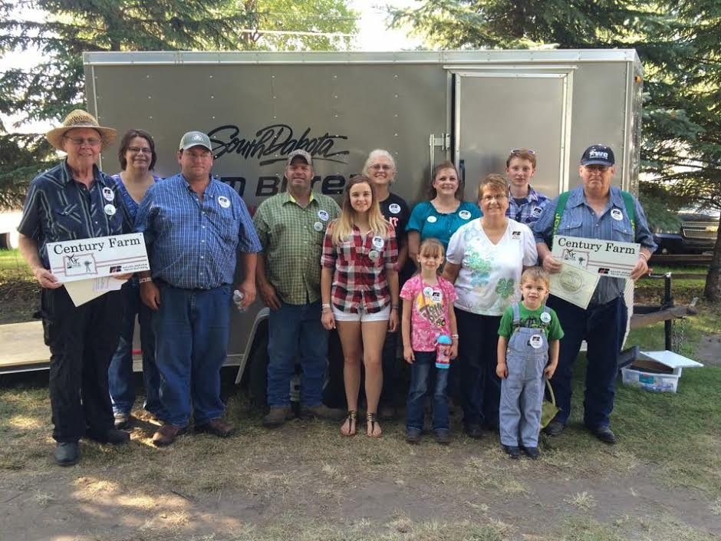
The Family and Socialization
My family shapes what I think of myself and how others treat me, even far into adulthood. My family made me who I am today. They taught me to walk, talk, read, and much more. My mom raised me, along with my step dad. My grandma took a lot of time to teach me how to read, and my grandpa taught me how to work cattle. They did a lot of me.

Slide 3
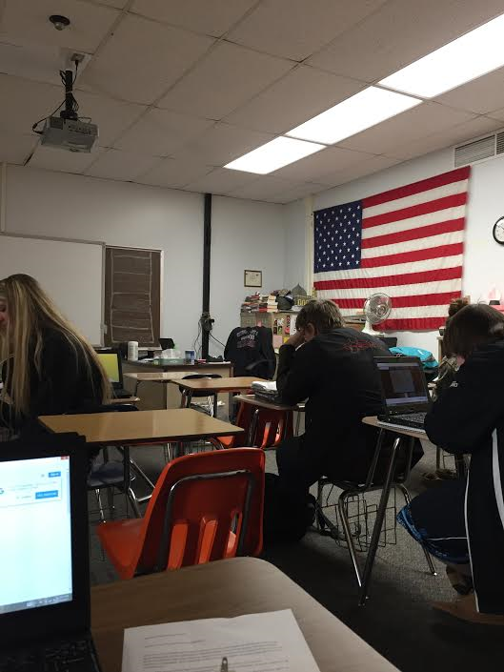
Socialization in school
Many of my relationships in school are impersonal. My rewards and punishments are based on performance rather than action. The teacher evaluates her students by more objective standards. We are taught to be less dependent emotionally on our parents. School creates feelings of loyalty and allegiance to something beyond the family. School is stressful and there is a lot of bullying that needs to stop.

Slide 4
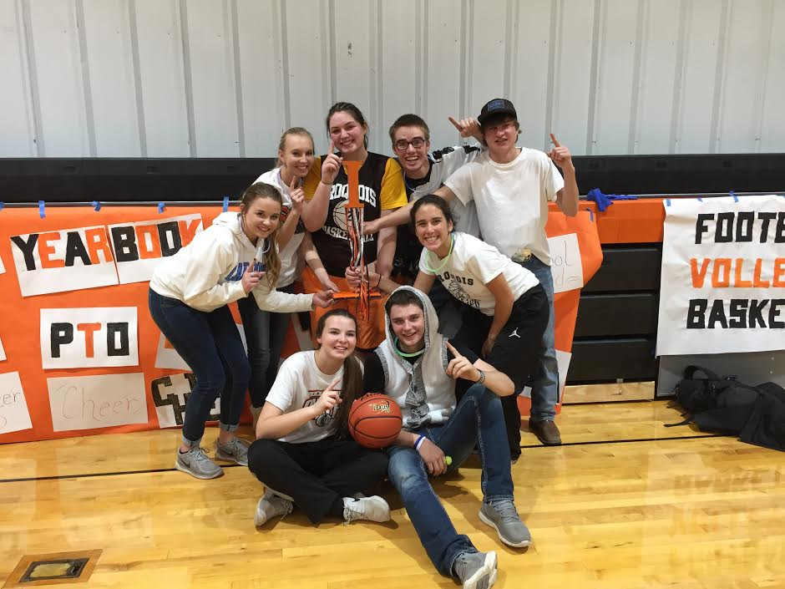
Peer Group Socialization
Peer group is a set of individuals of roughly the same age and interests. This picture describes a great peer group. We all get along! This group is the only agency of socialization that is not controlled by adults. We belong to a school where most people get along and there are really no “labels” on people. There is no “band geeks, Popular,” or anything.

Slide 5
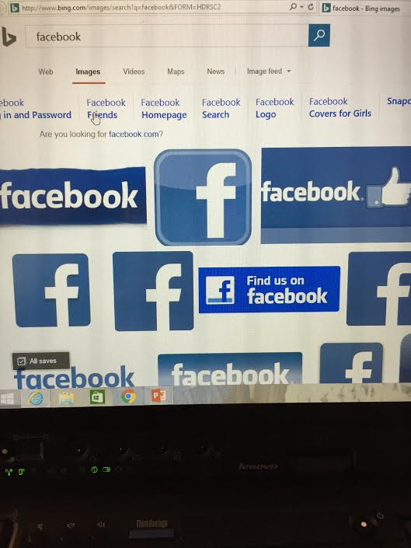
Mass Media Socialization
I use snapchat, facebook, Instagram, and twitter mainly. The mass media, by their content alone, teach many of the ways of the society. This is evident in the behavior we take for granted. Mass media offers children ideas about the values in their society.

